Slide 1
Growth lessons from the Refactoring Community
Danny Dig
CSCI 7000-008
Notes:
Growth is a word that is music to my ears.
I am excited to bring you three threads intertwined in my talk.
The first thread I will attempt to map the vast landscape of thousands of refactoring research papers in the last decade and our exponential growth. This will give you ideas on how your own community can experience growth and make a long-lasting practical impact.
Then you will see a second thread, where I will give some examples of the new growth from my own refactoring research with my graduate students, and I will even get to do a deeper dive into one of the most recent projects we worked on with our collaborators at Google.
But there is a Third Thread you will see in my talk.
So I present some of the lessons that I have been learning in my career and my personal life– and I wished that somebody shared these with me when I was a student. I will take you behind the scenes. I am so excited to serve you by sharing about my journey, where I am now and what I am learning in my personal and professional life. So when you see the Owl icon, I am about to share one of those insights. I am So excited to share these with you.
===
I understand that my talk is around 50 minutes then 10-15 minutes of Q&A at the end.
====

Slide 2
How many code refactorings last week?
0
1
2-3
3-5
5+

Slide 3
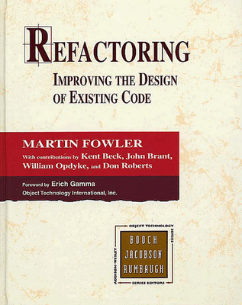
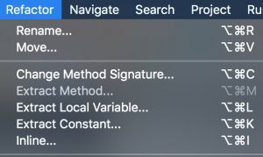


What is Refactoring?
“A change made to the internal structure of
software to make it easier to understand and
cheaper to modify without changing
its observable behaviour” – M. Fowler [1999]
Top-level menu in all modern IDEs
In 2000, I created the first
open-source refactoring tool
In 2004, I joined the team
To go fast, go alone. To go far, go with others.
Notes:
I want to give a little background on this important topic of refactoring from the field of Software Engineering. Many people, myself included were introduced to refactoring through the work of Kent Beck and Ward Cunningham from Extreme Programming, and then Martin Fowler’s seminal book on refactoring.
For me, refactoring was love at First SIGHT!
CLICK
I fell in Love with refactoring when I first read Martin’s fowler classic refactoring catalog in 2000, and I have been working on refactoring ever since.
Martin Fowler’s definition in the refactoring catalog.
ASK : CLICKER how many refactorings have done last week? Thank you. This also shows that the people who did not raise their hand had not written any code in the last month.
CLICK Refactoring is today a top-level menu in all modern IDEs, along with File, Edit, and so on.
CLICK I was fortunate to write the world’s first open-source refactoring tool for Java back in 2000, and I released it as a plugin for Jedit. For one year I was competing head-to-head with IntellijIDEA commercial refactoring tool from JetBrains, but then they beat me as they were a company with a full team of people.
CLICK I learned one my first important lesson: you need a team of people if you want to accomplish something of significance. If you want to go fast you go alone, if you want to go far, you go with others.
CLICK So I no longer ventured solo, but I joined the Eclipse refactoring team in 2004, when I started contributing to Eclipse IDE, the leading IDE for Java at that time.
====
CLICK A couple of other books that are big titles in industry and have influenced my path: Refactoring to Patterns and How to Work Effectively with Legacy Code.

Slide 4
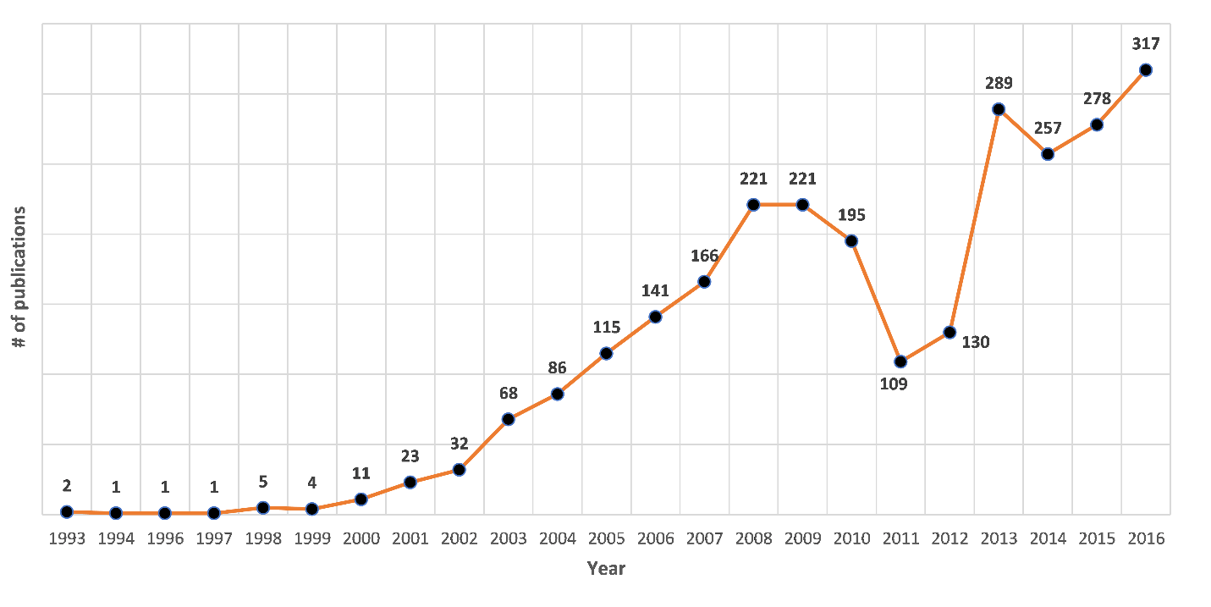
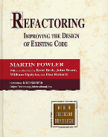
A Decade of Refactoring Research
2,880 refactoring papers since 1990
2,442 papers between 2005-2016
T. Mens
Notes:
On the academic side, refactoring research has also seen a tremendous growth, as seen in This graph.
On the horizontal axis we have the timeline from 1993-2016, and the vertical we have the number of peer-reviewed published papers on refactoring in each year.
If I had more time I would take to the origins of the research on Refactoring: it started concurrently and independently at two universities:
Bill Griswold and David Notkin at UW were looking at refactoring functional programs in Scheme.
Bill Opdyke and Ralph Johnson at Illinois were studying the refactoring OO programs particularly in the frameworks context
All of us who followed afterwards on the footsteps of these BOLD pioneers are grateful to them.
After the appearance of Martin’s Fowler Refactoring classic, a lot more academics started to pay attention to refactoring, and I was one of them.
At that time I was looking at what is the most active place of research in refactoring, so I joined Ralph Johnson’s research group in 2002 for my PhD work on refactoring.
But the period I want to focus in my talk is a more recent decade from 2005 until 2016.
More than 80% of all refactoring papers were published in the last decade
This decade is interesting because we see rapid rise, then some decline in the middle, and then an even more rapid growth
ACT: So we are going to do a tour-de-force on these 2400 papers.
Please turn to your neighbor and tell them: buckle your seatbelt.

Slide 5
Corpus of Papers
Work done by Marouane Kessentini and his team at Michigan
Scopus and Web of Science
- "Refactoring” in title, abstract, and keywords
- yielded 3277 papers
Refactoring definition:
- transformation with behavior preservation
Manual validation of ALL papers:
- each paper analyzed title, abstract (and sometimes content)
- 4 grad students who took a graduate class on Softw QA
- Kessentini (faculty) looked at the contentious papers
In the end we removed 397 papers
Notes:
Work done by Marouane Kessentini (who was Mohamed’s PhD advisor) and his team at U of Michigan. I was simply an advisor and consultant to the project, asking them questions and probing to explore different parts of the data, but they are the ones who did all the digging. So when you say me say “we” about this data, it really means Marouane and his students.
We Searched for the term "Refactoring” in title, abstract, and keywords
- yielded 3277 papers
Refactoring definition:
- transformation with behavior preservation
Manual validation of ALL papers:
- for each paper we read the title, abstract (and sometimes content)
by 4 grad students who took a graduate class on Software Quality Assurance with Marouane,
and they independently voted whether this was a refactoring paper.
If at least one said No, Marouane looked at the paper himself
in the end we removed 397 papers
So Now we are ready to share some of the Growth Lessons from our community.

Slide 6
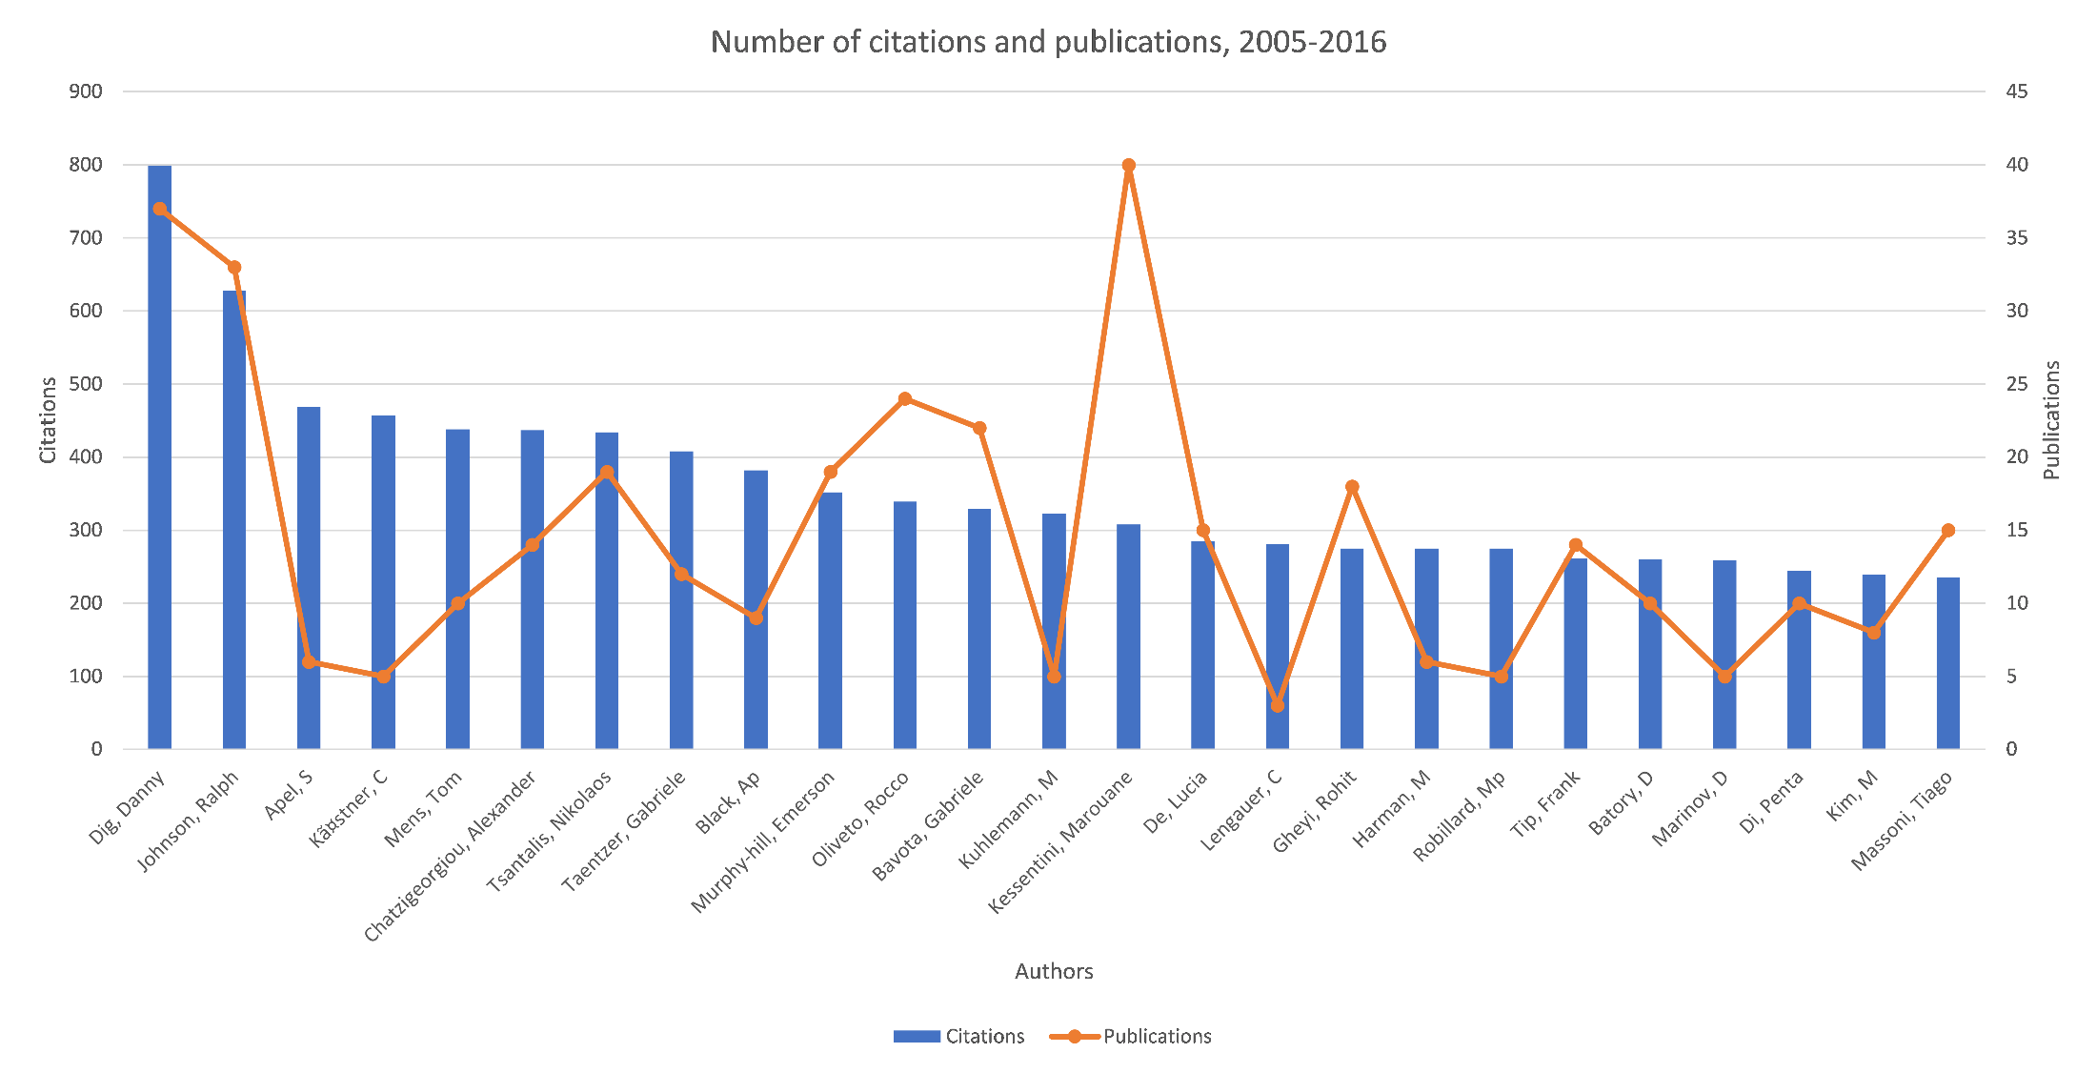
O1: To Grow, Welcome Outsiders, Champions from Other Communities
800 citations
37 pubs
Danny Dig
Apel, S.
Langauer, C
Batory, D
Ralph Johnson
Kastner, C.
Kuhlemann, M
For PhD committee, invite 1-2 outsiders of your area
Notes:
We first studied WHO is publishing actively in the last decade. This graph we look at the influence the most prolific authors have on the community, based on the citations to their refactoring papers.
I am overlaying on this graph two data points.
The blue bars show the total number of citations for refactoring papers, the orange line shows the total number of refactoring papers they published in the last decade..
CLICK: So on the left you can see authors like myself and Ralph Johnson that have both high number of citations and high number of papers, and are fairly established, the pillars of the community.
CLICK Of particular interest are some of the authors that you might recognize as active in other communities Generative Programming, Software Product Lines: Sven Apel, Christian Kastner, Don Batory, Lengauer, Kuhleman. .
The first observation: if you want your community to grow, be welcoming to champions and outsiders who are crossing from other communities.
The corollary: if you are champion from a community A into community B, you can be very influential and cited, despite not publishing a lot of papers in the new community
Teachable Moment: Even more specifically for you, as PhD students, when you form your PhD committee, be intentional in inviting 1-2 people from outside your area, as they can provide fresh perspectives and insights and can make your research more impactful.

Slide 7
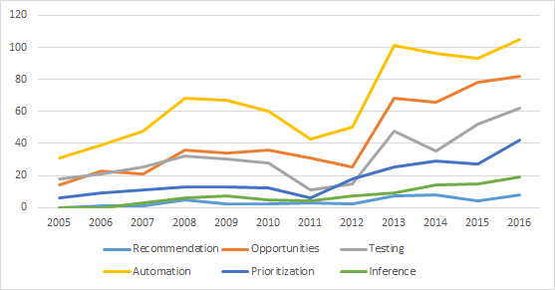
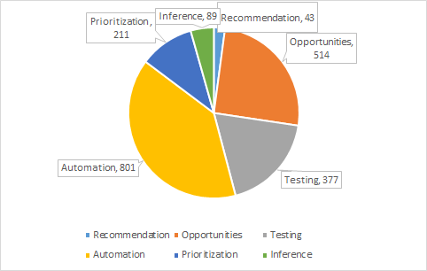
O2: To Grow, Expand Focus of Interest (the WHAT)
automating
insight
testing
prioritization
inference
recommendation
Expand to meet the needs of new audiences
Notes:
Second, we looked at what has been the focus of the research in the last decade.
On the X axis we have the timeline, on the vertical we have the number of papers published along different lines of focus.
The original focus was on automating the analysis and transformation for refactoring. Most of the research done today is still on Automating analysis and transformations.
Second most prolific line of research is to gain Insight where in the code we need to introduce refactoring),
In the beginning the community thought that the Insight comes solely from domain knowledge in the mind of the programmer, but now the community is working on generating Insight.
WHY: More developers are working on code that was written by other developers who left the company, they need to gain insight about which parts of the code need refactoring.
Prioritization: scheduling of refactoring opportunities. When programmers received hundred of recommendations, prioritization is becoming important as programmers cannot apply all the hundreds of recommendation.
Inference: tools for automatic detection of refactoring activities that already took place in the code. This is important for understanding the evolution of code, program comprehension, and many more applications.
CLICK>
The bottom line is To Grow, Expand the Focus, become broader, think about new audiences you are serving and how you can meet their needs.
===
Testing: the correctness of the code changes applied by the refactoring tool. ICST'16 had 4 papers on testing the correctness of refactoring tools. This makes sense about increasing the Trust of the refactoring tool (this is one of the most costs/barriers for people adopting these refactoring tools in practice, especially when people consider refactoring as an overhead cost of ensuring the correctness of the changes).
Recommendation part: what sequence of refactorings to apply to solve the problem. it does not apply automation support to apply the refactoring automatically.
Insight: I think a lot of the papers published in this vein of work come from people in the Technical Debt community.
Priotization: The growth spur is correlated with the growth of Technical Debt community (first workshop appeared in 2010)

Slide 8
Our New Focus on Automation
Scalability 1.0: Refactoring to Design Patterns contain hundreds of
lower-level refactoring steps [ICSE’16]
- 10x faster than state-of-the-art IDE refactorings
Scalability 2.0: Ultra-large scale refactoring for codebases of
Hundreds of Millions LOC (e.g., scale)
whole-program analysis is not feasible
The next generation of global, distributed refactoring [ICSE19]
MapReduce on the cloud: scalable, safe, useful
Notes:
I want to give some examples from my own’s research group and our collaborators in the area of automating refactoring.
SKIP this Slide tell them that we are going deeper into one of my recent works on automation
CLICK - SKIP if we need to save time.
In the area of support for automation, we see a whole new emphasis on scalability.
For example, together with my collaborator Don Batory from UT Austin and his students, we developed higher-level refactorings that introduce Design Patterns consisting of hundreds of lower-level refactorings such as Move Methods, yet we show that we can do this 10x faster than any of the state-of-the-art IDEs
CLICK
I think we are at the cusp of a new breed of refactoring tools that are more adapt to tackle the challenges of today’s codebases.
- For example, last year we were working with software engineers at Google. Their unique challenge is that the codebase is in the order of hundreds of millions of LOC, the code base is so large that it cannot fit in the IDE of any single computer, so they keep it in the cloud.
We are automating refactorings that replace a type T with a type R across the whole codebase, for example replace usages of HashMap with ArrayMap to improve runtime performance.
.
The current generation of refactoring tools require to load in memory the whole code base to analyze, which is not feasible to do at this scale.
CLICK
Together with the developers at Google, we are developing the next generation of refactoring tools that work in a distributed manner, using MapReduce on the cloud,
Our empirical evaluation shows that we can do global refactorings across the entire codebase of hundreds of Million LOC in a matter of 15 minutes, and we generated refactoring patches for hundreds of developers that accepted them, confirming they are useful

Slide 9
Our New Work on Inferring Refactorings
RefactoringMiner: commit-based detection [ICSE’18]
No similarity thresholds
High accuracy: 98% precision, 87% recall
Ultra-fast: 58ms on median per commit
Better than previous state-of-the-art: +22% precision, 7x faster
Largest and least biased refactoring oracle up to date
3188 true refactoring instances, 185 open-source projects
Enabling other researchers:
21 papers by others, within 1 year of our release
Notes:
Let me give some examples from another area of focus: tools for Inferring where refactoring already took place in the code. This is important for understanding the evolution of code, program comprehension, and many more applications such as supporting code merging, code reviews.
Refactoring inference has been a very active line of research,
This line of research has stiffled in the last 5 years, until it was reinvigorated recently by a new breed of tools that address limitations of the previous generation along the lines of accuracy and the user experimentation required to produce good results.
For example, RefactoringMiner developed by the group of our collaborator Nikos Tsantallis from Concordia University works at a much finer-grained: it takes as input consecutive commits, and it does not require that users play with any thresholds.
It is the new state of the art and significantly more accurate than previous tools, it is ultra-fast so it can be used with continuous integration tools every time when a user commits code.
Moreover, we have released the largest and most trustworthy dataset of 3000 refactorings from real-world projects that researchers for our community can use to validate your research, or industry can use for education.

Slide 10
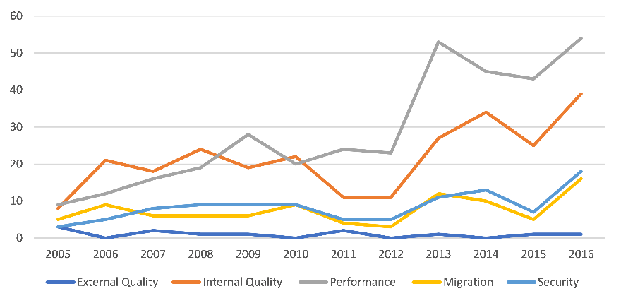
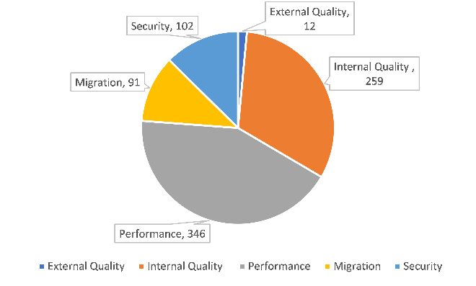
O3: To Grow, Expand Objectives (the WHY)
performance
internal quality
security
migration
Expand Objectives: new refactoring research is to improve
performance, security, migration (beyond internal quality)
Notes:
Next we ask the question: why do people refactor nowadays?
The original motivation was to improve the internal code quality, but we have seen huge growth in other objectives.
Very surprising: starting with 2010, performance was the main target, even more than Internal quality. Many people in the industry mention as the main goal for refactoring to be performance. the research community realized that the performance is more marketable: you can say that you make a change that might improve the maintainability of your software in a few years, but how do you measure this? In contrast, performance is quantifiable, has an immediate, measurable impact for end-users.
Migration: transformation between programming languages (COBOL to Java, C to C++,) or migrating between libraries.
And we have one of the most active and well known people in the library migration, Mohamed and his group.
CALL to ACTION: The surprising part is security: we would like to see more work on Security preservation when I integrate modules (in autonomous vehicles).
Can we still preserve the security constrains (not only the behavior)?

Slide 11


Overview of Our Refactorings for Asynchronous Programming for Mobile Apps
Slow operations freeze mobile apps and frustrate users
- 75% of performance bugs in Android [Li et al., ICSE’14]
Culprit: long running operations running in the main UI thread
Solution: refactoring for asynchronous execution
modern
async
sync
async
[ICSE’14]
performant
async
[FSE’14]
[ASE’15]
long-running
async
[FSE’16]
Notes:
Let me give some examples of refactoring for performance that my own research group has been automating in the domain of Mobile Apps.
The mobile domain has seen a huge growth.
Gartner predicts that this year more than 300 Billion apps will be downloaded this year.
However, because mobile devices have limited resources and make excessive network calls,
it is easy for mobile apps to freeze and become unresponsive.
A famous research paper found that slow operations account for 75% of the performance bugs in Android.
The main Culprit: long running operations running in the main UI thread
Solution: refactoring to execute these long-running operations asynchronously in other threads, and call back into the main thread with the result of the computation.
CLICK
However, refactoring code from a synchronous model to asynchronous is non-trivial, as the refactoring needs to preserve the original program behavior, the thread semantics, and even the order in which exceptions are thrown.
Once arrived in the promised land of async programming, the app developer needs further refactoring.
Even code that is designed with asynchrony upfront still needs refactoring in order to remain useful. For example to replace legacy call-back styles with modern constructs such as async—and-await, to make the async code more performant.
CLICK
Among these vectors of refactorings for improving responsiveness, we have automated some for different platforms (Android and Microsoft .NET) and for different programming languages (Java and C#).

Slide 12
Overview of Our Refactorings for Parallelism
Interprocedural analyses:
control, data-flow
points-to
constraint-based
Refactorings for thread-safety
- make class immutable [ICSE'11]
- convert to Atomic* classes [ICSE'09]
- use concurrent collections [ICSE'09]
- infer region annotations [ASE'09]
- atomic check-then-act operations [ICST’13]
Refactorings for throughput
- parallel recursive divide-and-conquer [ICSE'09]
- loop parallelism via ParallelArray [OOPSLA’10]
- loop parallelism via lambda functional operators [FSE’13]
Refactorings for scalability
- Atomic*, concurrent collections [ICSE'09]
Notes:
SKIP slide: or go very fast
In the interest of time I am going to skip this slide, but it summarizes my group’s work on refactoring for adding parallelism into sequential programs and improving parallelism in program that are already parallel.
SKIP from here on:
I also want to give some examples of refactorings for parallelism that my own group developed to help developers take advantage of multicore computers.
We first started with an exploratory study to find out how programmers change their code for parallelism. Grounded on the findings, we developed a rich refactoring toolset that supports refactorings from all practical categories that we discovered from the explorative study:
Typically, a user would first make a program thread-safe, and then make the program run concurrently under multiple threads, then improve scalability.
VIP: don’t talk about the individual refactorings, but only about the categories
Automating a refactoring for parallelism is challenging as it requires complex code transformations that span multiple, non-adjacent program statements (cannot be done via find-and-replace text editors), and requires deep inter-procedural analyses that globally reason about objects that threads can share through the heap. A key problem is designing program analyses that are accurate yet fast enough to be used in an interactive refactoring tool.
===================
1. The first category of refactorings are enabling transformations for thread-safety.
For example the first refactoring makes a whole class thread-safe by making it immutable. The next two refactorings convert accesses to shared data by using library constructs that are thread-safe.
2. Once a program is threadsafe, multi-threading can be used to improve its throughput.
Our toolset supports three such refactorings. First refactoring converts a sequential divide-and-conquer algorithm into an algorithm which solves the recursive subproblems in parallel using Java’s ForkJoinTask framework. Second refactoring parallelizes loops over array using ParallelArray libray, a data-structure that supports bulk parallel operations.
3. Refactorings for scalability convert an already thread-safe program into one which is more scalable.
These refactorings replace lock-based synchronization with more scalable techniques (e.g., Compare-and-Swap in Atomic classes).

Slide 13
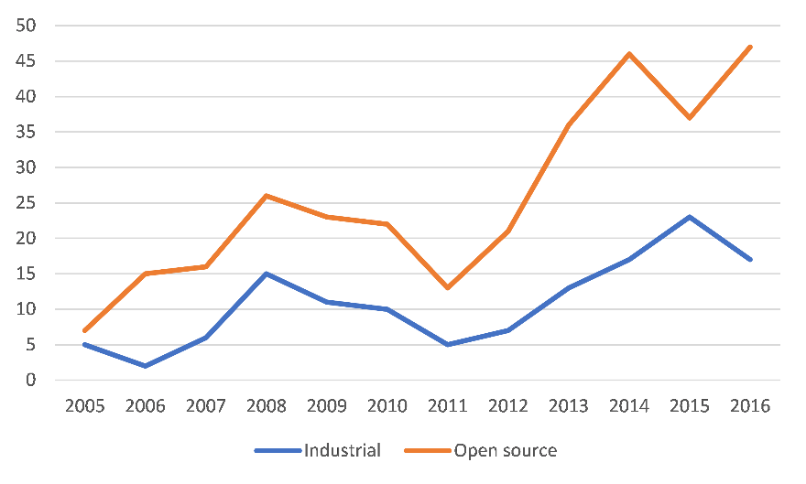
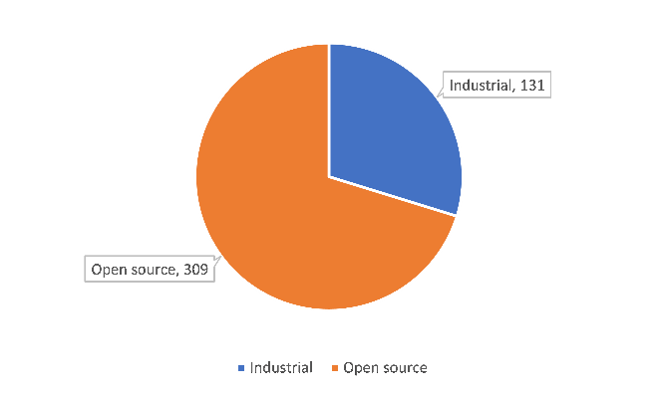
O4: To Increase Practical Impact, Go the Extra Mile
Open-source data
industrial data
Industrial collaboration levels:
- surveys with practitioners
- tool validated on industrial codebase
- tool licensed to industry, adopted in products
“There are no traffic jams on the extra mile”
Notes:
The next question that we asked is:
How do we know that our research works? The vast majority in the refactoring community employ empirical evaluation (as opposed to analytic evaluation with proofs of correctness)
These papers used open-source data: evaluation means applying the tool on some project, or replicating refactorings scenarios that open-source developers applied.
I am the most excited to see an increase in the number of refactoring papers that involve industrial collaboration. Collaborators from industry tried the tool, gave feedback, the code is used by the industrial partner with sub licensing.
CLICK
This is much harder to do as to bring business value to the company the researcher must go the extra mile and work harder.
VIP: As one of my mentors says, there are no traffic jams on the extra mile ☺ Because very few people put in the extra effort.
But this is the one that has the greatest potential for changing the world of software development.
Just a a few months ago we finished deploying one of our tools inside Google, and we performed large scale refactorings across the whole Google codebase – this was one of the most rewarding experiences.
======
Call for Action: if you are someone from industry (I know that there are people here from IntellijIDEA and other industry groups), invite academic researchers to talk about their work, demo their tools, be willing to try their tools and give feedback. We truly appreciate you and these interactions are invaluable.
It’s your honest feedback about what works and what does not work that makes us better and stronger and helps us create tools that make you more productive.

Slide 14






What is Your Dream? Mine is Practical Impact on SW Development
Automating
Inferring
- used at
- dozen labs
-ship with official
Refactoring
- hundreds of
accepted patches
founded Workshop
on Refactoring Tools,
HotSwUp, Dagstuhl S.
- first open-source
refactoring
Understanding
- shaped APIs in Java and .NET official concurency libraries
-learnparallelism.net 150,000+ visitors
Testing
Notes:
Here is another teachable moment for you in the audience.
Identify your Dream.
What do you want. What do you really, really want?
Do you want to publish papers? Do you want to have lots of citations?
My dream for me is making a practical difference in the life of real software developers.
CLICK
For example, several of our refactoring tools ship with the official release of IDEs such as Microsoft Visual Studio, NetBeans, Eclipse, AndroidStudio which are used daily by millions of software developers
CLICK
Using our tools, we generated hundreds of change patches that were accepted in famous open source projects such as Apache foundation
CLICK
Several years ago I developed the world’s first open-source refactoring engine for Java
CLICK
The work on inferring API-level refactorings is used at Google, IBM, and dozens of labs
CLICK
Some of our testing work has been integrated in the testing infrastructure of the NETBEANS IDE at Oracle
CLICK
moreover, the formative studies that we conducted to reveal misuse, underuse, and abuse of parallel constructs has already shaped APIs in Java and .NET official concurrency libraries
Some of the educational resources that we developed, have already received hundreds of thousands of visitors
CLICK
I am not telling you all this to impress you, but to impress upon you that it takes a mindset and dedication to identify what’s your dream and to pursue it. None of these adoption in industry have happened by chance, by publishing papers and then hoping that one day somebody in industry finds them. I was proactively pursuing industrial collaborations.
You might think that sometimes publishing papers is going in the opposite direction to your dream. I am learning how to make academic papers serve my dream by going the extra mile to move research into practice.

Slide 15
Big Growth of the Field: Expanding Definition
“Automation/insight/testing/prioritization of changes to the artifacts of software to improve non-functional requirements and without changing its proper, intended behaviour” – Danny Dig ‘19
“A change made to the internal structure of software to make it easier to understand and cheaper to modify without changing its observable behaviour” – M. Fowler ‘99
Expanded Focus, Objectives,
Techniques
Communities that grow are going to be more accepting of
new ideas
Notes:
The significant expansion of the refactoring definition. We can truly say that we refactored the refactoring definition.
CLICK> We have seen a significant expansion in the focus of the community (moving beyond automating changes to insight, testing, prioritization), the Target expanded
Beyond code to include models, Preservation of behavior has expanded to preserving the proper intended use of behavior, but removing the improper behavior (for example by eliminating security exploitable, hackable behavior, slow performance)
architecture, UI, DB, the objectives expanded beyond Internal Quality to Performance, Security, Migration, and the
CLICK> Communities that thrive are going to be more accepting to new ideas.

Slide 16
Big Growth Enabled by Community Engineering
Industry champions: Martin Fowler, Kent Beck, Ward Cunningham, Joshua Kerievsky, Michael Feathers, Uncle Bob
Complementary skills: tool builders, paper writers, curators
Mindset for industrial collaboration and adoption
Shared platform:
- Eclipse (Erich Gamma + Frank Tip), analysis frameworks
Community: 10 Refactoring Workshops, 1 Dagstuhl
first workshop in 2007, 50+ participants, 32 posters
invited all major IDE providers
growing new leaders
Notes:
Here are other factors, mostly on the social part, or community engineering that contributed to the growth and impact of our field.
Attracting strong industrial champions: we have seen that the field of research has really taken off only after Martin Fowler’s publication of the Refactoring book, and the campaign of influential thought leaders in industry like Kent Beck and Ward Cunningham (the Inventors of Extreme Programming)
CLICK Most people in the academic community are great at publishing papers, and we need to partner with people that have complementary skills, great tool builders.
We have seen this over and over again in the famous big successes in our community (Don Roberts and Jon Brant, Eclipse team: Frank Tip form IBM Research and the Eclipse Java Development Tools team in IBM Zurich).
We created a nice ecosystem with researchers supporting the industry and vice-versa.
CLICK Proactively seek industry collaborations: honest feedback can be painful to accept, but it is the pain that makes us grow stronger.
CLICK: having a shared platform that the community could build upon: We adopted Eclipse, it was open source (but developed like professional software of industrial strength quality, with yearly major releases, backed up by IBM). The documentation was so-so, but Eclipse had great developer support forums, researchers could learn from reading the source code of other refactoring plugins,
- Program analysis infrastructures, like WALA and SOOT.
CLICK Community Infrastructure:
We had 10 refactoring workshops, Dagistuhl seminar. I organized the first 4 refactoring workshops. At the first refactoring workshop I organized in 2007 at ECOOP, we had 50 participants, 32 of them presented posters and we had a big display of 32 refactoring posters that year in the mail hallways at ECOOP (about 2/3rd of all posters at ECOOP that year were on Refactoring), so on the hallways I heard other people talking how it seems that everyone at ECOOP is working on refactoring.
CLICK I also invited at all these refactoring workshops the people from industry who were building the refactoring infrastructure: at Eclipse, NetBeans, Intellij, Visual Studio. This was crucial for the research community to meet these industry people, learn about the undocumented features they needed to use, exchange tips and tricks
CLICK While I was the one in charge of the first 4 refactoring workshops, I realized I need to attract new leaders and make room for others to get involved in leadership, if this was going to take off and reach significant success
====
Time 2min:55sec

Slide 17
Type Migration in Ultra-large-scale Codebases
Ameya
Ketkar
Ali
Mesbah
Davood
Mazinanian
Danny
Dig
Eddie
Aftandilian
Notes:
I want to dig deeper into refactoring and give one recent example from my own’s research group and our collaborators on how we are automating new refactorings.
This is a project that started by one of my PhD students when he took a grad class with me, it started similar with the grad projects that our grad students are doing for their grad component.
The PhD student kept working on the project for one more semester after the end of the class.
CLICK
We are pushing the frontier of refactoring technology to tackle the challenges of today’s codebases.
Last year we were working with software engineers at Google. Their unique challenge is that the codebase is in the order of hundreds of millions of LOC, the code base is so large that it cannot fit in the IDE of any single computer, so they keep it in the cloud. So to perform global refactorings at the scale of Google and Microsoft codebases requires a whole new paradigm.
We are automating refactorings that replace a type T with a type R across the whole codebase, for example replace usages of HashMap with ArrayMap to improve runtime performance.
I am giving an overview of our work that appeared in this year’s International Conference on Software Engineering, and was led by my PhD student Ameya, in collaboration with researchers at UBC and Google.

Slide 18
Why perform type migration?
Better performance
Function<Double,Double> -> DoubleUnaryOperator [Ketkar OOPSLA ‘17]
Integer -> int
Improve Energy Efficiency
HashMap -> ArrayMap -> SparseArray [Saborido et al., EMSE ‘18]
Better functionality
T -> Optional<T>
Library Migration
log4J -> sl4j [Teyton et al., JSEP ‘14 ]
Fixing API breaking changes
Updating or moving fields and method [Dietrich et al., ICSME ‘14]
Notes:
<.> Better Performance …
Using generic Functional Interfaces causes Autoboxing and Unboxing between primitive and object types (e.g., int and Integer), which severely degrades performance [16]. Specializing Functional Interfaces effectively avoids the imposed overhead.
<.> Improves energy efficiency of the program
Replacing HashMaps with ArrayMap or SparseArray can make a big difference when computing in the DataCenter.
<.> Better functionality… Optional provides a null safety.
<.> Library Migration, for example going from
log4j to sl4j.
A library migration can be imagined as a batch type migration where one migrates from a set of types of one library to a set of types in another library.
<.> 20% of the API breaking changes involved updates in field and method signatures that required type changes.
Currently all these type migrations are predominantly performed manually by software developers which is tedious and error-prone.
I will present our approach which attempts semi-automate this task.

Slide 19
Existing Refactoring Tools for Type Migration
Tool | Config-ility | Safety | Scalability
IntelliJ IDEA
Refactor by example (Refaster)
Type Constraints
T2R (Our approach)
Configurability: Custom type migrations
Safety: Type correctness, completeness of mappings
Scalability: 300M LOC
Notes:
These are the desired features in a type migration tool:
Configurability : There are many reasons why a developer would want to migrate types as discussed earlier. Therefore a type migration tool needs to be configurable, so that developers could express their own customized type migrations.
Safety: Tool should be able to reason about type dependencies across the whole codebase, which requires inter-procedural analysis.
Scalability : Our open source corpus had most projects over 500KLOc and google’s code base of 300M LOC, thus scalability is desired.
<.> The most prevalently used Java IDE, IntelliJ IDE is not safe nor scalable.
While one can specify migration between two type, one cannot express mappings between it’s methods, so the IDE is doing a purely syntactic find-and-replace.
<.>Google uses a Refactor-by-example tool named refaster. It is an advanced multi search-replace tool upon ASTs.It is extremely configurable and can match over most kinds of AST expressions, but it cannot reason about semantics and therefore it is not safe for transitive type changes that propagate because of assignments, aliasing, etc.
<.> The previous state of the art was the work done by Frank Tip’s group who used a type constraint approach.
In this approach the entire source code i.e. each line of source code is reasoned about and is translated to type constraints. They use a constraint solver to reason how to propagate the type changes such that the type constraints are still satisfied after the refactoring. While this approach is safe, and somewhat configurable, generating type constraints and solving does not scale to analyzing hundreds of millions of LOC.
<.> Our tool (T2R) is configurable for several type migrations, safe and scalable to 300 MLOC.
Doing correct Type Migrations requires using an inter-procedural analysis, which is infeasible in ultra-large-scale codebases. So how do we solved this challenge?
===
I don’t know whether Frank Tip uses a SAT solver.

Slide 20

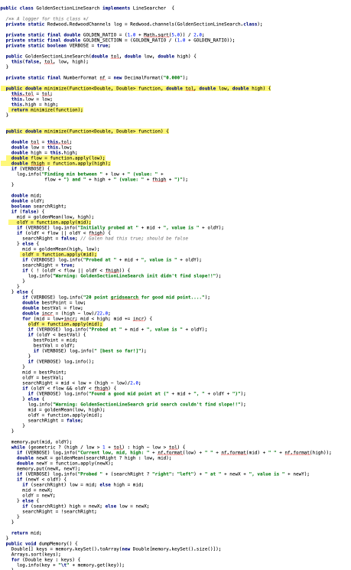
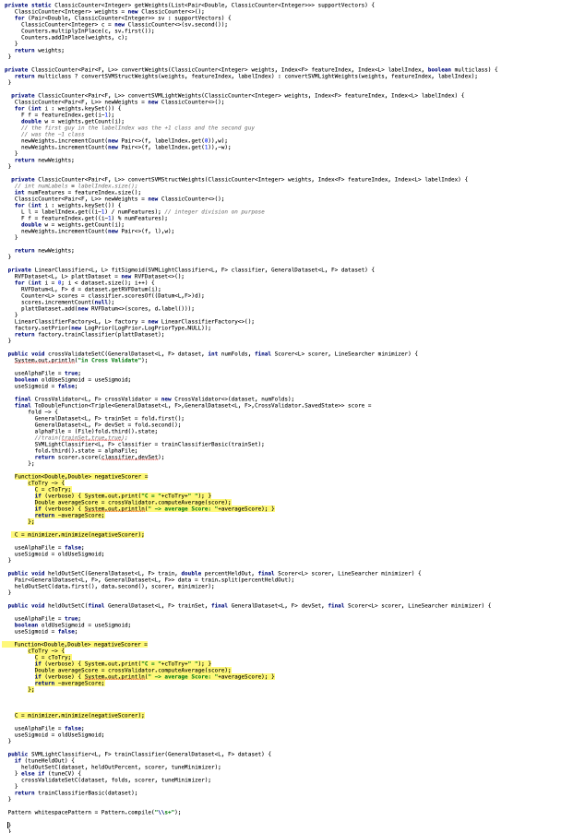
Key Novel Idea 1: Decrease Search Space
Reason about elements of the
“Source” type of the migration
Function<Double,Double>
DoubleUnaryOperator
Reason about:
Function<Double, Double>
Double
GoldenSectionLineSearcher
SVMLightFactory
Notes:
Our first key novel idea was to decrease the search space.
The traditional type constraints approach would reason about each type in the entire source code, irrespective of whether that type is involved in the type migration.
To scale our analysis, we only reason about program elements which belong to the types that are relevant to the migrations we want to perform.
For example: to migrate Function<Double, Double> we only reason about program elements of type Function<Double, Double> and Double and
all the program elements which have type dependencies on these program elements.
CLICK
The parts highlighted in yellow are the program elements that we feed to our static analysis, which is significantly smaller than the entire source code.

Slide 21
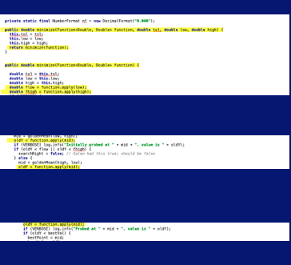
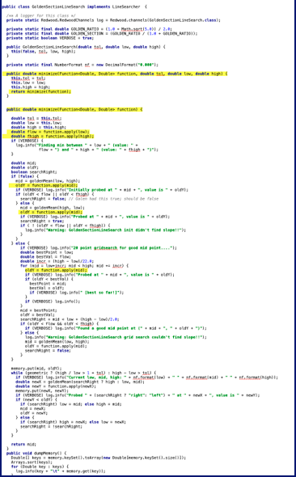
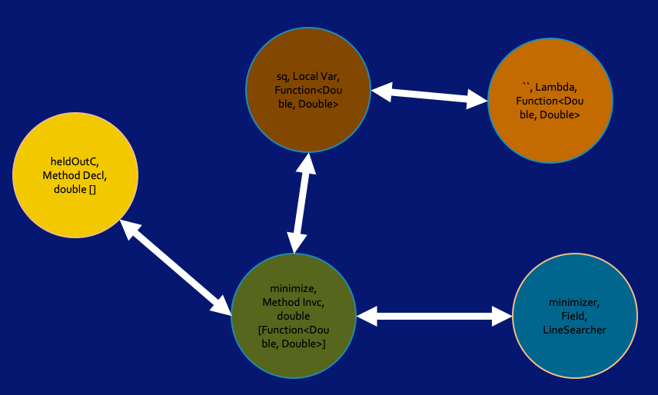
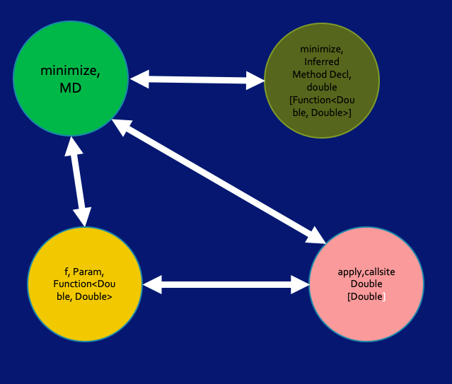
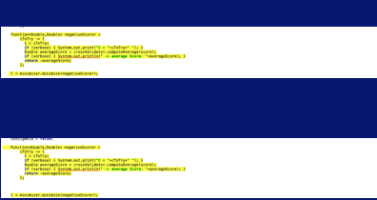
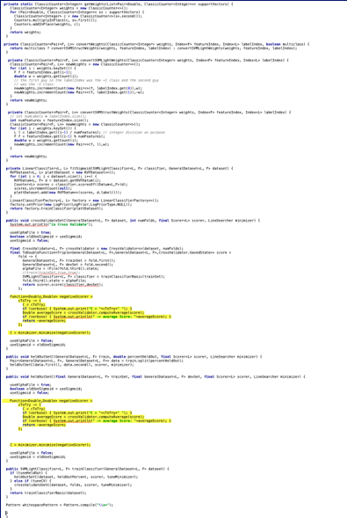
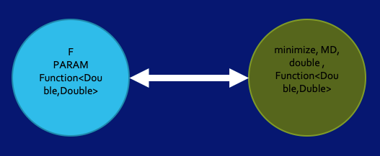
Key Novel Idea 2: Map-Reduce amenable
Type Fact Graphs (TFG)
Nodes: Program elements of type T
Labelled Edges: Encode type dependencies
e.g., Receiver, Assignment, Invocation
Notes:
The next key idea we used to scale this analysis and make it Map-Reduce amenable.
CLICK While we cannot process the entire source code of 300M LOC in memory, we could analyze each compilation unit/file independently. CLICK This is the MAP – phase.
CLICK So we “Map” each file to an abstract semantic graph we call Type Fact Graph.
A TFG captures the type-dependency relationship between different program elements.
We were inspired by the formalization of refactorings with graph transformations [18], and type constraints [7].
CLICK This graph contains nodes all program elements in the file which belong to type relevant to our migration and all other program elements which have some kind of type dependency upon them.
CLICK The edges represent type dependencies between the source code elements represented by nodes for example: assignment, method contract, type hierarchy, so on.
So far this is the INTRA-procedural part of the analysis since it only reasons about type dependencies within a single file.
===
Once we map each file to type fact graphs we just serialize them into the file system since one cannot keep 100s of 1000s of such graphs in memory.

Slide 22
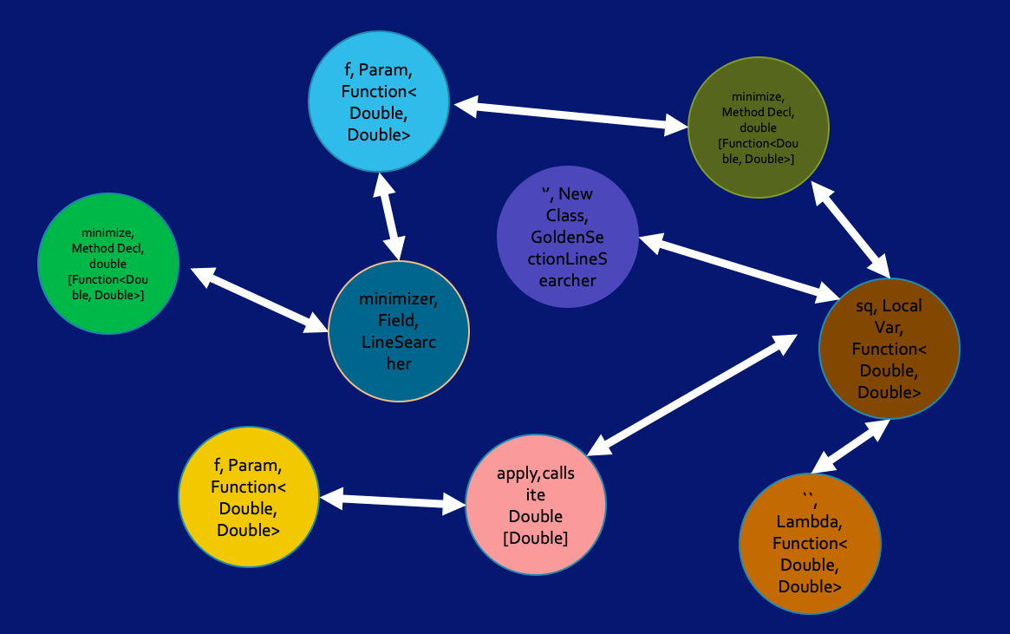
Key Novel Idea 2: Map-Reduce amenable
Merge TFG: Discover type dependencies among source code elements beyond the individual file
Merge TFG: Commutative and Associative
Notes:
While in the earlier step we mapped the file to a TFG which captures type dependencies amongst the source code elements in one file,
Now we need to discover type dependencies across the entire source code.
To do this we merge the graphs that we collected in our previous ”map” stage.
A merged TFG will express type dependencies amongst the source code elements transitively across the entire source code.
To further scale this analysis: We observed that the merge operation on the TFGs is associative and commutative, and the empty graph is the identity.
We used this observation to further scale the merging of TFGs, because the order of input graphs and order of merge operations does not matter.
Thus, we can mimic an inter-procedural, whole program analysis, and because we use MAPREDUCE parallel and distributed computing, our analysis is scalable to ultra-large-scale code bases.
===
The graphs are bidirectional labeled graphs (e.g., bidirectional helps with I can merge in any order that I traverse, and also merging become easier;
It is also more natural to express type dependencies; for example, in an assignment the LHS must be a supertype of the the RHS, and the other way around, so we encode both constraints.

Slide 23
Apply Transformation Rules
Function<Double, Double> ChangeType to DoubleUnaryOperator
apply ChangeName to applyAsDouble
ChangeType to DoubleUnaryOperator
ChangeType to DoubleUnaryOperator
ChangeType to DoubleUnaryOperator
ChangeName to apply
Notes:
After we obtain the merged graphs, we enrich the nodes of the graphs with change instructions.
These instructions are derived from the specifications provided by the user on how to Map the Source and Target Type, expressed through our DSL.
For example, using our DSL a user will give the mappings on how to change declarations from Function<double, Double> to DoubleUnaryOperator
And corresponding callsites from apply to apply as double.
These change instructions are the edit actions that need to be performed upon the source code element that the node represents.

Slide 24
Empirical Evaluation
Used T2R to migrate 13 generic functional interface types to their specialized,
performant types
Open Source Corpus: 7 best in class, performance-critical applications,
2.6 MLOC
Google Corpus 300M LOC
RQ1: Applicability: How applicable are T2R type migrations?
A: 139 type migrations in projects previously optimized for specialized functional types
RQ2: Scalability: How scalable is T2R? A: 33 minutes for Google’s Java codebase
Notes:
To evaluate our approach and T2R, our implementation, we write mappings for a dozen migrations from Java generic functional interfaces to their specialized, performant types.
The original Generic Functional Interfaces causes Autoboxing and Unboxing between primitive and object types (e.g., int and Integer), which severely degrades performance [16]. Specializing Functional Interfaces effectively avoids the imposed overhead.
As a corpus: We use seven open-source, performance-critical projects which are mature and popular (thousands of stars on GitHub) and are widely used in the industry, and extensively use Functional Interfaces.
These projects are: CASSANDRA, PRESTO, NEO4J (best- in class, scalable and highly-performant databases).
Finding any missed opportunity to further specialize functional interfaces in such projects, is an important contribution.
To evaluate our approach, we formulate the following research questions :
<.> How applicable are the type migrations in real world projects and how safe is our tool?
To answer this question we check how many patches when applied do not produce syntactic errors, type errors and test case failures.
Even in highly optimized projects, where developers had already manually refactored code to use specialized Functional Interfaces.
T2R found 139 opportunities for improving performance by migrating their generic types.
CLICK: To answer scalability, we measure the size of the codebase T2R could handle. We throw the world’s largest piece of Java code that we know of today.
T2R required 33mins to analyze Google entire Java code of 300 MLOC

Slide 25
RQ3: Usefulness Do developers find our type migrations useful in practice?
139 patches sent to the original developers as pull request. 126 patches were accepted and 10 still under review
2 patches rejected because developer did not like the name “Predicate”
1 patch rejected since it affected the public APIs
“This patch was deep inside the database and actually is very important for performance”
“Thanks for the nice contribution. The team would enjoy continuing the discussion.”
“Nice to be able to detect this automatically. Presumably, we have missed a number of them. … You will get a “fame spot” in Speedment”
Notes:
To evaluate the usefulness, we sent these 139 type migration patches as pull requests, out of which 126 patches were accepted by the original developers.
The ones that were rejected were because developers did not like the name Predicate used in the Java standard library, they preferred Function<String, Boolean>
But overall, The developers accepted most our patches.
Remember that the projects in our corpus like cassandra or presto were extremely fine-tuned for performance and their code heavily scrutinized.
Presto is a distributed DataBase used by Facebook and other internet companies.
which is the leading software for Big-data processing, and is used by every single one of the Fortune 500 companies.
But people here know CASANDRA very well because Ken Anderson and his students have been using it and gave nice tutorials on Cassandra for years.
The developers at cassandra were really excited when my student Ameya submitted 15 such migration patches for different parts of the code.
One of the lead architects at CASANDRA, Jeff Jirsa said that one patch was deep inside the databased code, and affected their caching logic and was extremely important for their performance.
You can imagine how proud I was of my student having his patches accepted in CASSANDRA,
SonarQube
Thanks for the nice contribution. I'm sure that the SonarJava team would enjoy continuing the discussion. and even hiring my PhD student.
Speedment
Sounds cool! Nice to be able to detect this automatically. Presumably we have missed a number of them... Make sure to sign the contributor license agreement and you will get a "fame spot" in Speedment main POM file!

Slide 26
Summary
A MapReduce amenable technique for type migration: emulates inter-procedural analysis at large scale
Type Fact Graphs – models type structure of a program
T2R – our implementation for specializing Java’s functional interfaces
Evaluation of T2R on 7 open source projects and Google’s Java code
Usability: 98% of the total patches generated were accepted
Scalability: 300M LOC in 33mins
T2R and corpus available for download
Notes:
Our work shows that by using a graph modelling the type dependencies in the source code, we can mimic an inter-procedural program analysis, which is amenable to the MAPREDUCE parallel and distributed computing, and there fore, is scalable to ultra-large-scale code bases.

Slide 27
My Most Important Investment
Ameya Ketkar (PhD’21, now at Uber)
Michael Hilton (PhD’17, now at CMU)
Semih Okur (PhD’16, now at Microsoft)
Yu Lin (PhD’15, now at Google)
Stas Negara (PhD ‘13, now at Google)
Ameya Ketkar (PhD)
Malinda Dilhara (PhD)
Tom Dickens (PhD)
Sruti Srinivasa (PhD)
Shane McKane (MS’17, now at Intel)
Mihai Codoban (MS ‘15, now at Microsoft)
Kendall Bailey (MS ‘15, now at Intel)
Cosmin Radoi (MS ‘13, now PhD student UIUC)
Sandro Badame (MS ‘12, now at Google)
Fredrik Kjolstad (MS 2011, now PhD student MIT)
Binh Le (MS 2009, SW developer)
Can Comertoglu (MS 2009, now at Microsoft)
Jacob Lewis (Summer’16 – ‘17)
Jonathan Harijanto (Summer’16 –’17)
Lily Mast (Summer’15)
Elias Rademacher (Summer’15 - current)
Nicholas Nelson (Summer 2014-15)
Sean McDonald (Summer’14 –Fall’15)
Hugh McDonald (Summer’14 – Fall’15)
Alexandria Shearer (Summer’12)
Kyle Doren (Summer’12)
Lyle Franklin (UIUC, Summer’12)
Alex Gyori (UIUC, Summer’12)
Yuwei Chen (UIUC, Spring 2012)
Anda Bereckzy (UIUC, Fall’11-Spring’12)
Alex Sikora (UIUC, Fall’11)
Jack Ma (UIUC, Summer’11)
Lorand Szacaks (UIUC, Summer’11)
Caius Brindescu (UIUC, Summer’11)
Mihai Codoban (UIUC, Summer ‘11)
Mihai Tarce (UIUC, Summer’09)
Cosmin Radoi (UIUC, Summer’09)
John Marrero (MIT, Spring’08 – Summer’08)
Notes:
While I like building novel tools, my greatest joy comes from building people and investing myself into people. I was fortunate to work with great students.
I have learned as much from them as they have learned from me.
Among the 19 undergrads that have done research with me, I inspired half of them to continue with a PhD program.
My passion is to help my students maximize their potential and inspire them to become tomorrow’s leaders.
====
s

Slide 28
Work in Your Strength Zone but Reinvent Yourself
Mobile [’13 - ’18]
-add async
-fix async
-privacy
Parallelism & Concurrency
[’08-’13]
Refactoring
- make thread-safe
- improve throughput
- improve scalability
Library migration [’02-’07]
- upgrade APIs
programs
IoT and ML [’19– TBD]
-from deterministic to probabilistic
Principles for changing between different programming models
Notes:
Many times, people might tell you that you need to be good at everything: The truth is that you cannot be an expert on everything, you need to know a little about everything (so that you can see connections) but focus on the area that you are passionate about and you are good at (I call this the strength zone). Spend most of your time and energy in that area, do not attempt to be good at everything, because then you will be average and mediocre at everything.
This is my personal story of working on refactoring. I’ve been working on refactoring for 20 years.
When I meet people at the conferences, they ask me about my current work, and I tell them that I still work on refactoring. They ask me: Danny, Don’t you get bored working on the same refactoring topic?
<CLICK> During my 5 years of PhD I worked on Upgrading library-based applications to use the latest API of their libraries, even when these APIs were refactored. In this stage I learned about static program analysis and learned the Eclipse refactoring engine so well that I became a contributor to Eclipse.
<CLICK> Just as I was finishing my PhD in 2007, the world of computing was completely shaken up when Intel stopped producing single processor systems, and went into multicore.
So my interest shifted towards refactoring existing sequential programs to make them run in parallel, make programs thread-safe, and refactorings to improve the scalability of already parallel programs
This new world forced me into much deeper program analysis than I have done before.
<CLICK> But just about when I started to get comfortable with parallelism, the world changed again. People stopped buying laptops and everyone was on mobile devices. So I took what I learned from the parallelism domain, and adapted it to the new challenges of working with event—driven apps.
<CLICK>: now I am making the transition to yet another big domain: the digitalization of our world with IoT and how the sensors around us will collect information about us and the world that will augment our intelligence. In this new paradigm, how do we refactor existing programs that use deterministic algorithms into programs that use probabilistic computation and ML and continuously learn?
Key lesson that I learned: many times I ventured beyond refactoring into other areas (like HCI or Compilers) that were weakness for me. I kept failing over and over until I learned to partner with others who were strong in the areas I was weak.
CLICK
I decided to stay and work in my strength zone: principles for refactoring programs between significantly different programming models, both in terms of the control-flow (from synchronous to callback-based, from sequential to parallel) and program state (from stateful to stateless execution, and from shared- to distributed- memory style of communication)
But at the same time I keep an eye open on big changes in the field of computing, and I am reinventing myself every 5 years. This way I remain fresh and keep learning while I stay in my strength zone
==
Gesture: stand in the middle and point at the screen at the different areas.

Slide 29
What’s coming next
Next class: read the Overview of IoT from the Internet Society
focuses on IoT applications and areas of challenges, growth for the sector
Next class meeting will be special:
- live interview and discussion with Ricky Singh, VP of IoT at Software AG
Submit questions you want to ask Ricky on Piazza ahead of time (I will create a page)

Slide 30
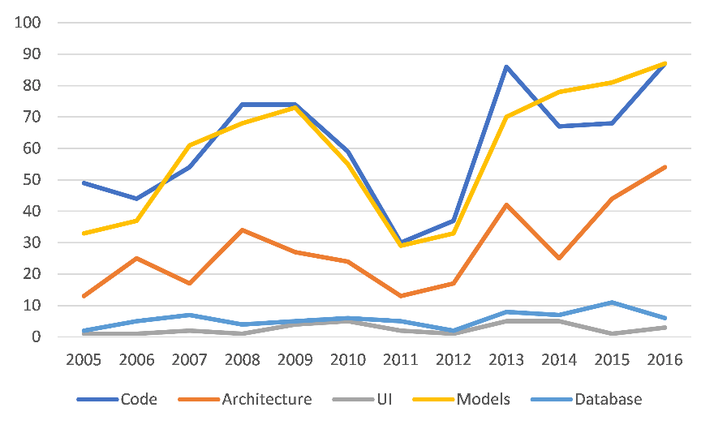
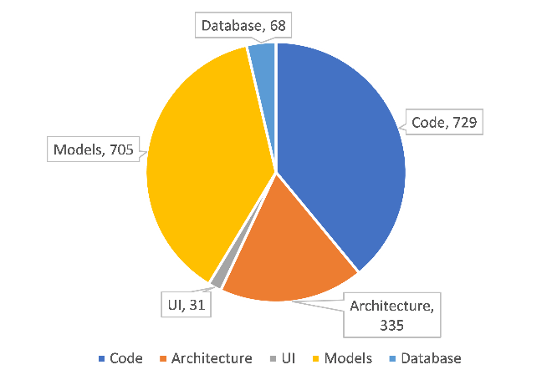
O3: To Grow, Expand the Target Artefacts
models
code
architecture
DB
UI
Expand target: new refactoring research is about change to the code, models, architecture, DB, UI
Notes:
Getting back to the trends we have seen in the corpus of 2400 refactoring research papers.
Next we ask the question of what is the target of the new refactoring tools?
The original target of refactoring has been the code, Refactoring code has been dominant, but other researchers also targeted new artefacts such as model refactoring, architecture refactoring, refactoring databases, and refactoring the UI.
Surprising: in the last few years, refactoring for models has surpassed refactoring code. Some of the very active researchers are Gabriele Taentzer, which we saw in one of the previous slides of impactful people.
VIP: Lots of room to grow in other areas. For example, in the Big Data era, a prolific direction could be refactoring of Data and Models used in ML systems.
===
For example for the TechDebt community, I would like to see a lot more work on the BIG_refactorings, architectural-level refactorings, as this is where we can make the biggest ROI on reducing TechnicalDebt
For example, in the BigData era, a fertile direction could be Refactoring DATA

Slide 31

Refactoring research growth
2,880 refactoring papers (4,944 authors) since 1990
Notes:
On the academic side, refactoring research has also seen a tremendous growth, as seen in This graph.
On the horizontal axis we have the timeline from 1993-2016, and the vertical we have the number of peer-reviewed published papers on refactoring in each year.
CLICK
Couple of observations from this graph.
First - Refactoring research started a decade before we saw the huge success and adoption in industry.
Second – we see that the huge splash of refactoring in industry, triggered by Martin Fowler’s book and the release of commercial-grade refactoring tools, in turn have triggered a huge interest of refactoring on the academic side.
The success of refactoring is because of the intertwined thread of industry/academic work.
I believe your department also values working closely with industry, so having strong industry connections could be a catalyst for growth.
----
so having strong industrial tools for detecting and eliminating technical debt can be one of the triggers for the growth of your community.

Slide 32
The Humble Beginnings
First refactoring paper:
- Bill Opdyke and Ralph Johnson [SOPPA’90]: Refactoring, an
Aid in designing application frameworks and evolving OO systems
First PhD dissertations:
Bill Griswold ‘91 at U of Washington
Bill Opdyke ‘92 at U of Illinois
Don Roberts ‘99 at U of Illinois
Refactoring research hard to publish in early 90s
- conflated with the compiler community
Notes:
SKIP this slide to save time, but mention the pioneers and how grateful we are to them in the next slide.
This is where I talk about the champions and the pioneers of the field.
First published paper: in 1990: at University of Illinois: By Opdyke and Ralph Johnson (my former PhD advisor, who most people would remember as one the GangOfFour authors of Design Patterns). First research paper that introduced refactoring as a means to extract reusable abstractions from existing applications and create frameworks from applications.
CLICK
Refactoring: was invented concurrently and independently at two universities:
Bill Griswold and David Notkin at UW were looking at restructuring functional programs in Scheme.
Bill Opdyke and Ralph Johnson at Illlinois were studying the restructing of OO programs particularly in the frameworks context
Don Roberts PhD dissertation was the first one to present an industrial-strength refactoring tool for Smalltalk, he worked with John Brant who as an amazing tool builder. Their tool, the Smalltalk Refactoring Browser heavily influenced Martin Fowler and Kent Beck, and all the refactoring tools that followed up.
At that time I was looking at what is the most active place of research in refactoring, so I joined Ralph Johnson’s research group in 2002 for my PhD work on refactoring.
I asked every single one of these pioneers what it looked like to research in refactoring in the early 90s and they all told me how hard was to publish as the research community looked at refactoring and said that it looks like compiler transformations, but they did not have the guarantees, the rigor and the formalism that the compiler community was used to. I highly appreciate our pioneers, they had to go through the pain of their research papers being initially rejected by the scientific community, but this paved a new way of thinking about interactive program transformation tools that put the programmer in the loop.
All of us who followed afterwards on the footsteps of the trailblazers are grateful to them.

Slide 33
Reflections and Lessons I am Learning
Notes:
ASK: the organizers: how are we doing with time? How much time do I still have left?
When they say 10 minutes, make a joke and say the organizers just gave me another 20 minutes to talk.
I am coming now to the Second part of my talk, on reflections and lessons that I am learning. I wish that somebody told me these when I started. I want to share these lessons with you, they will be useful for you, students and junior faculty in the webinar so that you can go further than I did, reach higher than I did.
In this part you will have unprecedented access to
behind-the-curtain information on how I do research;
Some of these are brand new insights that I have never shared before.
I am So excited to add lots of value to you.
So Why am I sharing these personal lessons with you?

Slide 34



L3: Proactively Look for Opportunities, but Be Flexible
Expected Company | Actual Company | Expected Target | Actual Target
Lambda
Expressions
Lambda
Expressions
Async
Programming
Type migration at scale
Notes:
I value close interactions with industry. But these interactions don’t happen by chance, we have to intentionally look for industry partners.
Story1: In 2012, The Workshop on Refactoring Tools was held in Zurich Switzerland.
<CLICK> I arrived a day early and I went to IBM in Zurich and met with the developers for the Eclipse refactoring tool. I spoke with them about refactorings for the upcoming lambda expressions in Java 8. They told me that Eclipse compiler will not support lambda expressions for another year. I was disappointed but this did not stop me from looking for other partners. The next day at the refactoring workshop I met with the developers of the refactoring engine for <CLICK> NetBeans IDE from Oracle. They told me that the javac compiler infrastructure on which the NetBeans IDE was built, already supported the lambda expressions, so when I got home I hired two undergrads who worked on two <CLICK> refactorings targeting lambda expressions that we shipped with the official NetBeans IDE.
The lesson of the story: you have to be flexible and work with another company, learn another technology.
<CLICK> Story 2: Story with Google manager, Eddie from the Java tools. Large scale type migration from Functional Interfaces to Specialized Functional Interfaces for efficiency. We generated hundred of patches in Google code that were accepted by Google engineers.
The lesson: Once you start working with an industrial partner, You need to be flexible with the scope of the work and be willing to learn a new technology.
==
I went to Google, to the Android Studio team to transfer the refactoring for asynchronous programming that I presented in the beginning of my talk. <CLICK> They liked this work, but they told me they are more excited about refactorings that improve security and privacy for Android apps. <CLICK> We started working together this year, and Google demo-ed a preliminary version of our refactoring at the Google I/O conference last year.

Slide 35

L4: To Grow Others, First Grow Yourself
Do you have a plan for your personal growth?
How do you get better at what you do?
How do you improve your relationships?
How do you hire great students?
How do you mentor and grow them into tomorrow’s tech leaders?
How do you prioritize the important over the urgent?
Notes:
A major theme in my talk today has been about growth: How do we grow a community, how do we grow research programs. We need to first grow on the inside, before we experience and sustain growth on the outside. We need to grow ourselves first before we grow others in our teams. If you came to TechDebt by taking a flight, the flight attendance announced before take off: in the unlikely event of cabin pressure dropping, First put on your oxygen mask before assisting other passengers. You cannot give what you don’t have.
I used to believe that I will automatically grow through experience. But I am discovering that experience is not the best teacher, some of us just go through life, others grow through life. I am discovering that evaluated experience is the best teacher, having the mindset to intentionally learn and grow from experiences.
I am surrounding myself with other like-minded professors who are intentional and dedicated to grow ourselves. We have weekly round-table discussions and We are intentionally studying with each other how to become a better person, better mentor for our students, better parent, better spouse.
For example, this last week, the discussion we had was on character, and while it was tempting to discuss about the character or lack of character in our students, we discussed about how we grow our character. The weekly challenge was to interview 3 people that know us well and to find out gaps between who we say that we are, and who we really are. I asked my wife and it was mind-opening to see the gap from her viewpoint on how I think I am a leader for our children at home, and how in the last few months I got so sidetracked into the new industry-university research consortium that I am starting together with NSF and other universities, and how I have missed to be engaged at home in these last few months of intensive travel to industry. While it was painful to hear this, Pain causes growth.
It was the accountability of my weekly roundtable group that gave me the courage to ask these difficult questions. We grow together and this is contagious.
If you are interested about starting your own roundtable growth group, please contact me to get some ideas.
We also have a mentorship roundtables for faculty at Main ICSE conference, I am the chair. Please sign up today as we still have a few seats.
I really wished I had known this earlier in my career, I wished somebody had a group like this when I was a student, or a junior faculty, I can’t imagine where I would be now if I had started on this journey 15 years ago.

Slide 36

Call to Action
Big growth enabled by “refactoring” the refactoring
L1: work in your strength zone, but reinvent yourself
L2: find your dream and then live it
L3: proactively look for opportunities, be flexible
L4: to grow others, first grow yourself
If you want to go fast in life, go alone. If you want to go far, go with others.
Contact me at digd@eecs.oregonstate.edu
- you have codebases where you retrofit ML computations
- finding your own peer-best-practices, like-minded group
Attend Ultra-large Scale Refactoring: Friday at 4:20pm, Prog. Transf.
Join Faculty Mentorship Roundtables (Wed-Fri), limited seats, sign today
https://2019.icse-conferences.org/track/icse-2019-Faculty-Mentorship-Lunch
Notes:
“Change is the only guaranteed constant”
This is good news for us who work in the refactoring field, because this means that as long as there will be software changes, we will stay employed.
The refactoring research community has been thriving and experiencing exponential growth because we refactored our definition of refactoring, we were open to new ideas and newcomers, so that we can better serve the industry needs.
CLICK In the second part of my talk, I shared some of the lessons that I am learning myself and how they have helped me tremendously:
- Working in the areas of your strength, finding what you truly value, being intentional on searching for opportunities, and placing yourself in a stimulating environment of like-minded people that sharpen each other and grow.
CLICK Last summer I was on vacation in the Glacier National Park where I have done some long and strenuous epic hikes together with my two friends, and I was reminded of a proverb If you want to go fast in life, go alone. If you want to go far, go with others.
CLICK
We need to start a dialogue and help each other in a few areas:
- If you are from industry and you have codebases where you need to replace deterministic algorithms with some that are probabilistic and use ML and continuous learning, please contact me.
Also, if you need ideas on finding your own group of like-minded peers that you can learn from each other, please contact me.
Finally, I would appreciate your feedback on today’s presentation. As soon as we are over, jump on the email: and let me know you would like to voice your opinion. I will send you an anonymous survey about what did you find the most the most valuable points from today’s talk, or if something that you disagree with.
Please email me because I want to be totally in tune with what you experienced during my presentation today.
Finally, I want to end with two ways I can serve you while here at ICSE:
If you want to find out about our recent work on Ultra-large scale refactoring and how we apply this on the largest Java codebase in the world, please attend our ICSE talk on Friday afternoon. My PhD student is presenting our paper and he is worried that because it’s the last session of ICSE he will not have a large audience. Please come and support him.
Second: I invite you to be in a roundtable conversation with some of the legendary mentors in our community and with your peers to discuss how you can grow and get unstuck from whatever circumstance that blocks you. Sign up today for the mentorship roundtables (you can find this on the Main ICSE webpage), we still have a few seats, reserve yours today before they are all gone.
Paris, I think it is time to take some questions now.
========
Optional<<
I am looking forward to partner with you to further advance the field of refactoring.
Together We will produce results that (a) change the way people program,
(b) create a platform for research for the next 10 years, and
(c) produce results that become standard software development practice in 15 years
<<<
industry, manager, or academic researcher. We are conducting now a large-scale empirical study on how people use refactoring in open-source projects. If you have any questions about the practice and adoption of refactoring, please contact me.

Slide 37
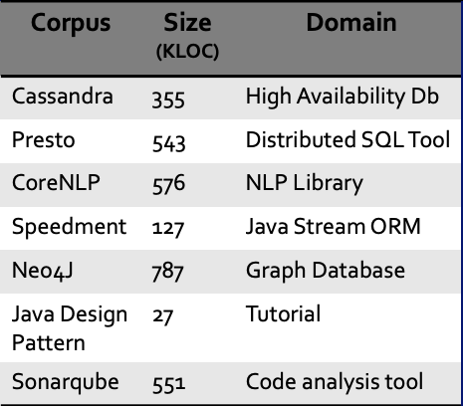

Software Corpora
Open Source Corpus
Google Corpus
300 million Java LOC
Notes:
To answer the research questions we create a corpus of open source and proprietary projects
For the open source we chose highly optimized, heavily used and best in class open source projects.
For example: Cassandra/Presto/Neo4j are very popular database engines used heavily in industry
CoreNLP is a very popular NLP project by Stanford, Java design patterns is the most starred Java Github Repo and
Sonarqube is a source analysis tool used by 1000s of developers across the world.
And an Proprietary corpus, which consisted of entire java source code of google.
Upon this corpus we used T2R to convert the usages for 7 Generic Functional interfaces like Function<Double, Double> to their 35 specialized form like DoubleUnaryOperator.

Slide 38
How accurate are the type migrations performed by T2R ?
143 migrations (TFGs) passed the preconditions 139 migration patches when applied, compiled and with no test failures i.e. were accurate
4 failed the integration test cases due to dependence on scala code and dependency injection
Notes:
Evaluation of T2R over the two corpora produced 143 patches.
Out of the 143, 139 were accurate i.e. when applied the build was successful and all test cases passed .
The ones which failed were due to reflection and dependence on other JVM languages like scala

Slide 39
Motivating example
import java.util.function.Function;
interface LinearSearcher {
double minimize(Function<Double, Double> f);
}
import java.util.function.DoubleUnaryOperator;
interface LinearSearcher {
double minimize(DoubleUnaryOperator f);
}
class GoldenSectionLineSearcher implements LinearSearcher {
@override double minimize(Function<Double, Double> f) {
return f.apply(getValue());
}
class GoldenSectionLineSearcher implements LinearSearcher {
@override double minimize(DoubleUnaryOperator f) {
return f.applyAsDouble(getValue());
}
class SVMLightFactory {
LinearSearcher minimizer = new GoldenSectionLineSearcher();
public double heldOutC() {
Function<Double, Double> sq = x -> x*x;
return minimizer.minimize();
}
}
class SVMLightFactory {
LinearSearcher minimizer = new GoldenSectionLineSearcher();
public double heldOutC() {
DoubleUnaryOperator sq = x -> x*x;
return minimizer.minimize();
}
}
Where to make the changes?
Type dependency relationships
What changes to make?
Mapping between methods
Analyze 300M LOC
Notes:
On the LHS is an interface LinearSearcher with a single abstract method 'minimize’ , which returns double, and accepts a parameter of type Function<Double, Double>.
On the RHS, is a refactored form of LineSearcher where the parameter of the method ‘minimize’ has been changed from Function<Double, Double> to DoubleUnaryOperator
This is what type migration is.
However to highlight the intricacies associated with type migration and understand why performing this type migration is difficult manually lets extend the example.
This is a simplified version of a real world change that we applied to Standford’s CoreNLP project.
<.> GoldenSectionLineSearcher is a class which implements the LinearSearcher interface implementing the minimize method.
<.> SVMLighFactory instantiates GoldenSectionLineSearcher, and invokes the minimize method in the method heldOutC.
WHERE TO MAKE THE CHANGE?
Now if one wants to migrate Function<Double, Double> To DoubleUnaryOperator, to avoid autoboxing.
The developer will have to reason about type dependency amongst source code elements in each class and across all the classes.
For example:
* LinearSearcher and GoldenSectionLineSearcher have hierarchial relationship between them, therefor the signature of minimize has to be consistent across the two classes.
* Also the declaration and invocation of method minimize have a contract to be obeyed. So if the parameter type of minimize changes in its declaration, the types of the arguments passed to the invocation of
of minimize will have to be changed accordingly.
WHAT CHANGES TO MAKE?
One will also have to reason about the mappings between the methods of the two types. For example: here “apply” changes to “applyAsDouble”
Java also has a lot of language constructs like anonymous classes, lambdas, arrays, new class and so on.
One can imagine that doing this manually is a very cognitively heavy and tedious task.
Also performing this analysis over a code base of 300MLOC is almost impossible

Slide 40
Filter: Preconditions
Availability of mappings
Function<Integer,String>
IntFunction<String>
apply
apply
compose
andThen
identity
No External Dependencies
Supplier<Integer> s = …
IntSupplier s = …
logger.trace(s);
Custom preconditions as graph expressions
Notes:
Then we check precondition the merged TFGs :
We check for availability of mappings. Its possible, that types are isomorphic but not completely replaceable.
For example, if one is trying to migrate from Function<Integer,String> to IntFunction<String>, there is no replacement mapping for methods like
andThen, compose or identity. So any instance when any of these three methods are used, cannot be migrated.
Second we check if there is no external dependency that prevents the migration.
For example, log4j’s trace method accepts an argument of type Supplier.
However if we pass it a Supplier<Ingteger> as shown in the example, this Supplier Integer cannot be
Migrated to IntSuppplier since, trace doesnot accept argument of type IntSupplier and we do not have access to source code of log4j so we cannot edit it.
One could additionally provide custom precondition to prevent changes from proliferating into certain packages, or public method and so on .
All the TFGs that satisfy these preconditions are serialised into the file system.

Slide 41
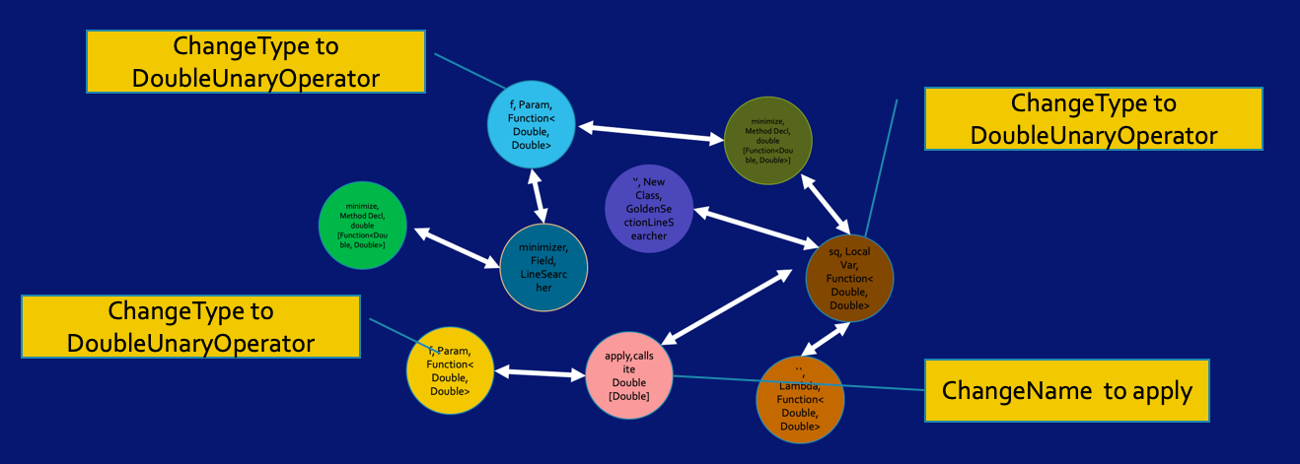
Transform
import java.util.function.DoubleUnaryOperator;
interface LinearSearcher {
double minimize(DoubleUnaryOperator f);
}
class GoldenSectionLineSearcher implements LinearSearcher {
@override double minimize(DoubleUnaryOperator f) {
return f.applyAsDouble(getValue());
}
class SVMLightFactory {
LinearSearcher minimizer = new GoldenSectionLineSearcher();
public double heldOutC() {
DoubleUnaryOperator sq = x -> x*x;
return minimizer.minimize();
}
}
Notes:
We again parse the entire source code, and everytime we visit a type relavant program construct we query the
Persisted TFGs from our previous stage, and check any TFG consists of a node which represents the visited prgram construct
We then read the change instruction in the node and execute the appropriate edit action upon the program construct.

Slide 42

Implementation
Reusable Artifact Badge at ICSE ‘19!
Built upon Google’s Error Prone (a Java compiler extension), which works with the build system
T2R uses
Java’s parallel stream (fork/join framework) in open source
JavacFlume (MapReduce) infrastructure in Google
TFG is represented using Guava Graph Library and serialized with protocol buffers
Instantiated T2R for specializing Java’s generic functional interfaces to 35 specialized form
A DSL to express the mappings between type T and type R
Notes:
We realized this approach as an IDE independent tool named T2R. We built it upon, Google’s error-prone java compiler.
The TFGs have been implemented using the Guava Graph Library.
The serialized representation of graphs has been implemented using Google’s protocol buffers.
We also implemented a POC at Google.
To evaluate our approach we provided T2R with mappings from 8 generic functional interfaces to their specialized form.

Slide 43
Future Work
T2R could be used to express and perform type migrations between isomorphic types like Java collections to Eclipse Collections
However the expressiveness of the migrations is limited by the changes the DSL can express
Open Question: A comprehensive catalog of changes to be expressed for a general type migration tool
Notes:
The artifact evaluation committee awarded us the Reusable Artifact badge for the implementation of T2R which specialized java’s functional interfaces.
Please visit the website to try our tool and look at the results.
We provide a DSL for expressing mappings between program constructs of the two types.
One of the limitations is that the expressivness of the DSL limits what edit actions T2R can do. Currently one cannot make changes beyond renaming elements or removing adding params.
However, it is also unknown what is the comprehensive set of edit actions that are required to support migration between any abitary type.
We have already written 46 mappings for specialising java’s functional interfaces, however
The biggest limitation of T2R is that only I can extend this tool to incorporate other type mappings. It is cognitively heavy to create mappings for T2R.

Slide 44
Value to Industry that You are missing out
PPI positions you as the Big Picture thinker
- access diverse interdisciplinary thinking
- bounce off ideas: helps you move in the right direction
Leverage the collective effort
- don’t have to build a team from scratch
Credibility without doing all the work to create momentum
Notes:
My Mentor John Maxwell says: Everything rises and falls on Leadership.
I want you to first see the value that leaders from our founding industry companies get, and what you are missing out.
CLICK> The PPI Center positions you professionally as the Big Picture thinker in your organization. The scale and complexity required to build tomorrow’s Intelligent IoT systems
systems is beyond what any leader can successfully think about it on their own.
Others are already seeing the big picture, you don’t want to be left behind.
When I asked Fernando Pereira, the VP of ML and AI at Google, he said that for him as a leader it’s important to have access to this diverse thinking brought by the other industry leaders in the Center, the Center faculty and students, the national agencies.
A month ago I talked with an executive from Daimler during a discovery visit as they are joining our Center and he said he is looking for bounce-off ideas on whether they are moving in the right direction.
Another executive said that he went to grad school and is familiar with the state of the art in AI from 1-2 decades ago, he needs to get acquainted with the recent state of the art, recent advancements.
CLICK> Second, the Center gives you a great creative outlet and resource to grow, you can leverage the collective effort of the other companies in the Consortium, you don’t have to build a team from scratch.
CLICK> Third, This will bring you great credibility, without requiring you do all the vast work and spend the energy to create momentum.
We are all leaders in this room and we know the great amount of time and effort that it takes to create a world-class thinking team, and the energy required to create and sustain this momentum.

Slide 45
See what Your Team is missing out
Collaborate on industry-wide challenges
- accelerate transfer
- share best practices
- broaden the perspective
- standardization
Leverage access and resources
- critical mass of experts
- leverage $30M existing investments
50+ PhD students: internships, hiring
Global companies
Mid-size industry
Startups
Universities
Notes:
Some some of the things that your team and your company is missing out:
CLICK Several good things happen when industry and academia collaborate:
Accelerate the transfer of ideas from research and publications into the hands of industry, and viceversa learn from industry about the state of the practice, the scale and complexity of real-world challenge.
You miss being at a round-table where companies and teams that might otherwise compete in the marketplace, do not reinvent the wheel but share their best practices with each other. We create a diverse ecosystem with global corporations that have maturity and know how to build scalable solutions and medium size and startups that have more agility and can try out ideas faster.
Having such conversations at roundtables enables standardization so that products and services can talk to each other.
Last but not least, an IUCRC Center is about leveraging access to people (and we have a critical mass of experts, colleagues from industry and academia)
We have faculty like Tom Dietterich who is an ACM Fellow and is widely regarded as the Father of ML, Margaret Burnett, another ACM Fellow (this is one of the highest distinction in the Field of CS, second only to getting the Turing Award prize which is the equivalent of Nobel Prize in CS)
Leverage access to resources: leverage more than $30M dollars of investments that the faculty in the Center bring from other funding sources;
What I heard from you loud and clear during visits is that you need access to students that are already engaged with your technology, that you have vetted over a long period of interactions.
I talked with one of the VP of IBM (Ramesh Gopinath), and he told me that onboarding or retraining an engineer to be be productive is on average 6 months.
What does it mean if you can hire one of our grad students in the Center, bring them on your team on the critical path for your business?
====
We involved several partners: When putting together the award-winning team, my philosophy was to work in our strong zone, and partner with others in areas where we are weak. At OSU we are very strong in areas such as Data Science and Security, so we partnered with University of Colorado to leverage their complementary strengths on Systems and PL. In the future, we will bring on more universities in the Center, as we will see more needs raised by the industry.

Slide 46
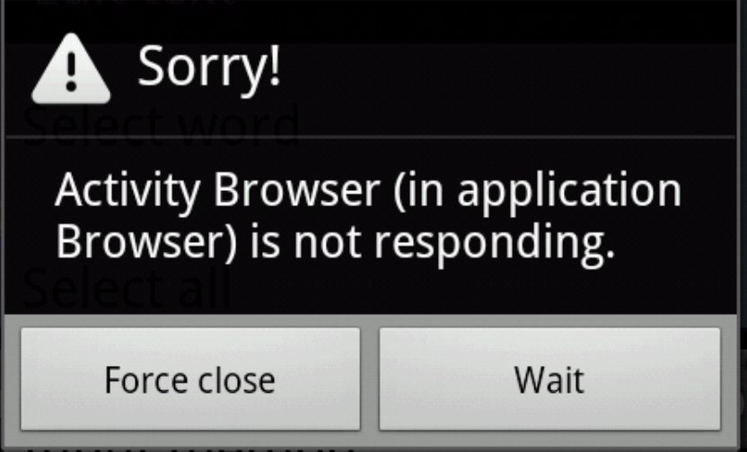
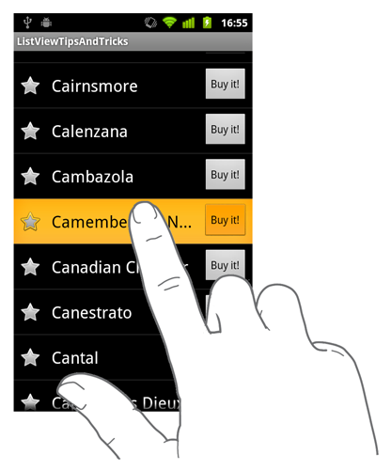

Why are Apps Unresponsive?
…
onStart
App Process
onKeyUp
UI thread
onClick
Event Queue
Notes:
So what makes apps unresponsive?
CLICK
event-driven model.
Events include user actions such as button clicks and swiping a finger, sensor inputs (such as GPS and changing screen orientation).
The programmer writes code in event handlers to respond to events.
CLICK
events placed in an event queue. For example,
CLICK
All mobile platforms use a single-thread model to process events handlers in the UI Thread.
CLICK
However, if the UI thread processes a handler that contain a blocking I/O call such as accessing the cloud CLICK, it can not respond to other events, and the UI freezes thus producing this screens CLICK that frustrate users.
ASK: Have you ever used an unresponsive mobile app?
App developers need to change their apps if they want to be successful.
The well known technique to improve responsiveness is to use asynchronous programming.
Asynchrony helps a procedure call is posted in a non-blocking manner CLICK to a background thread, while the main thread continues along.
When the background async operation has finished, it calls back into the main thread with the result.
===========
So what makes apps unresponsive?
CLICK
All mobile platforms use an event-driven model.
Events in mobile apps include user actions such as button clicks and swiping a finger, sensor inputs (such as GPS and changing screen orientation).
The programmer write code in event handlers to respond to events.
CLICK
When events are generated, they are placed in an event queue. For example, here we already have two events in the queue waiting to be processed, and now we add a third.
CLICK
All mobile platforms use a single-thread model to process events handlers in the UI Thread.
CLICK
However, if the UI thread processes a handler that contain a blocking I/O call such as accessing the cloud CLICK, it can not respond to other events,
and the UI freezes thus producing this screens CLICK that frustrate users.
ASK: Have you ever used an unresponsive mobile app?
App developers need to change their apps if they want to be successful.
The well known technique to improve responsiveness is to use asynchronous programming.
Asynchrony helps an app to stay responsive because a procedure call is posted in a non-blocking manner CLICK to a background thread, while the main thread continues along.
When the background async operation has finished, it calls back into the main thread with the result.

Slide 47
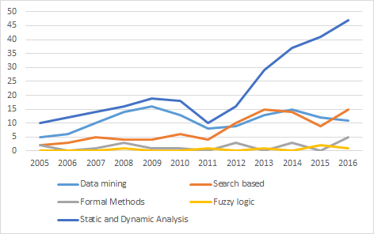
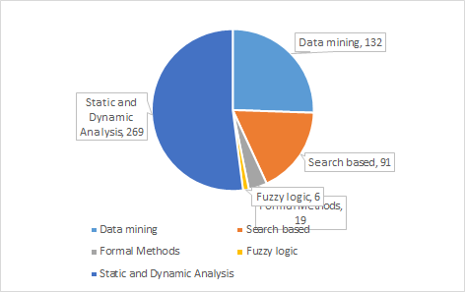
O5: To Grow, Adopt new Techniques (the HOW)
static & dynamic
analysis
search-based
data mining
New refactoring research via static analysis, search-based,
data mining
Notes:
We see that the bread-and-butter is still static analysis: people using compiler representation (AST, binding information and control-flow), more sophisticated analyses include heap-based abstractions such as points-to analysis
The increase of search techniques is scalability (paper that use methods like GA, simulate anealing) the growth was caused by the growth of the optimization field with multi-objective search
Data mining – this is a place where students in this class you are well positioned to make significant contributions. for people who want on technical debts, prediction of refactoring, they are trying to mine existing data to infer outcomes.
The availability of the data, lots of tools now that record the changes made in the code
The spike comes from the growth of the MSR community
====

Slide 48
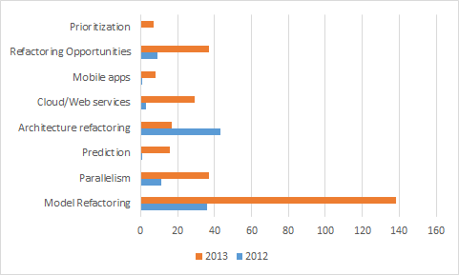
The Big Growth from 2012-2013
Notes:
Lets look now at the big growth spur that happened from 2012-2013> Switch to Slide #5
When done, switch back to slide 13

Slide 49
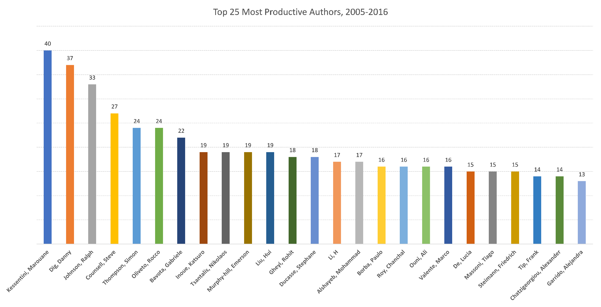
Who?
4,944 distinct authors (2,442 papers between 2005-2016)
Top 25 Most prolific authors, 2005-2016
40
13
Notes:
There are several thousand authors, so the community is wide, but it is also deep. This graph shows the top-25 most prolific authors, and the height of the bar shows the number of refactoring papers they published in the last decade.
We see some authors publishing extensively, like my collaborator Kesentini (40 papers), myself at 37, and Ralph John, my former PhD advisor.

Slide 50
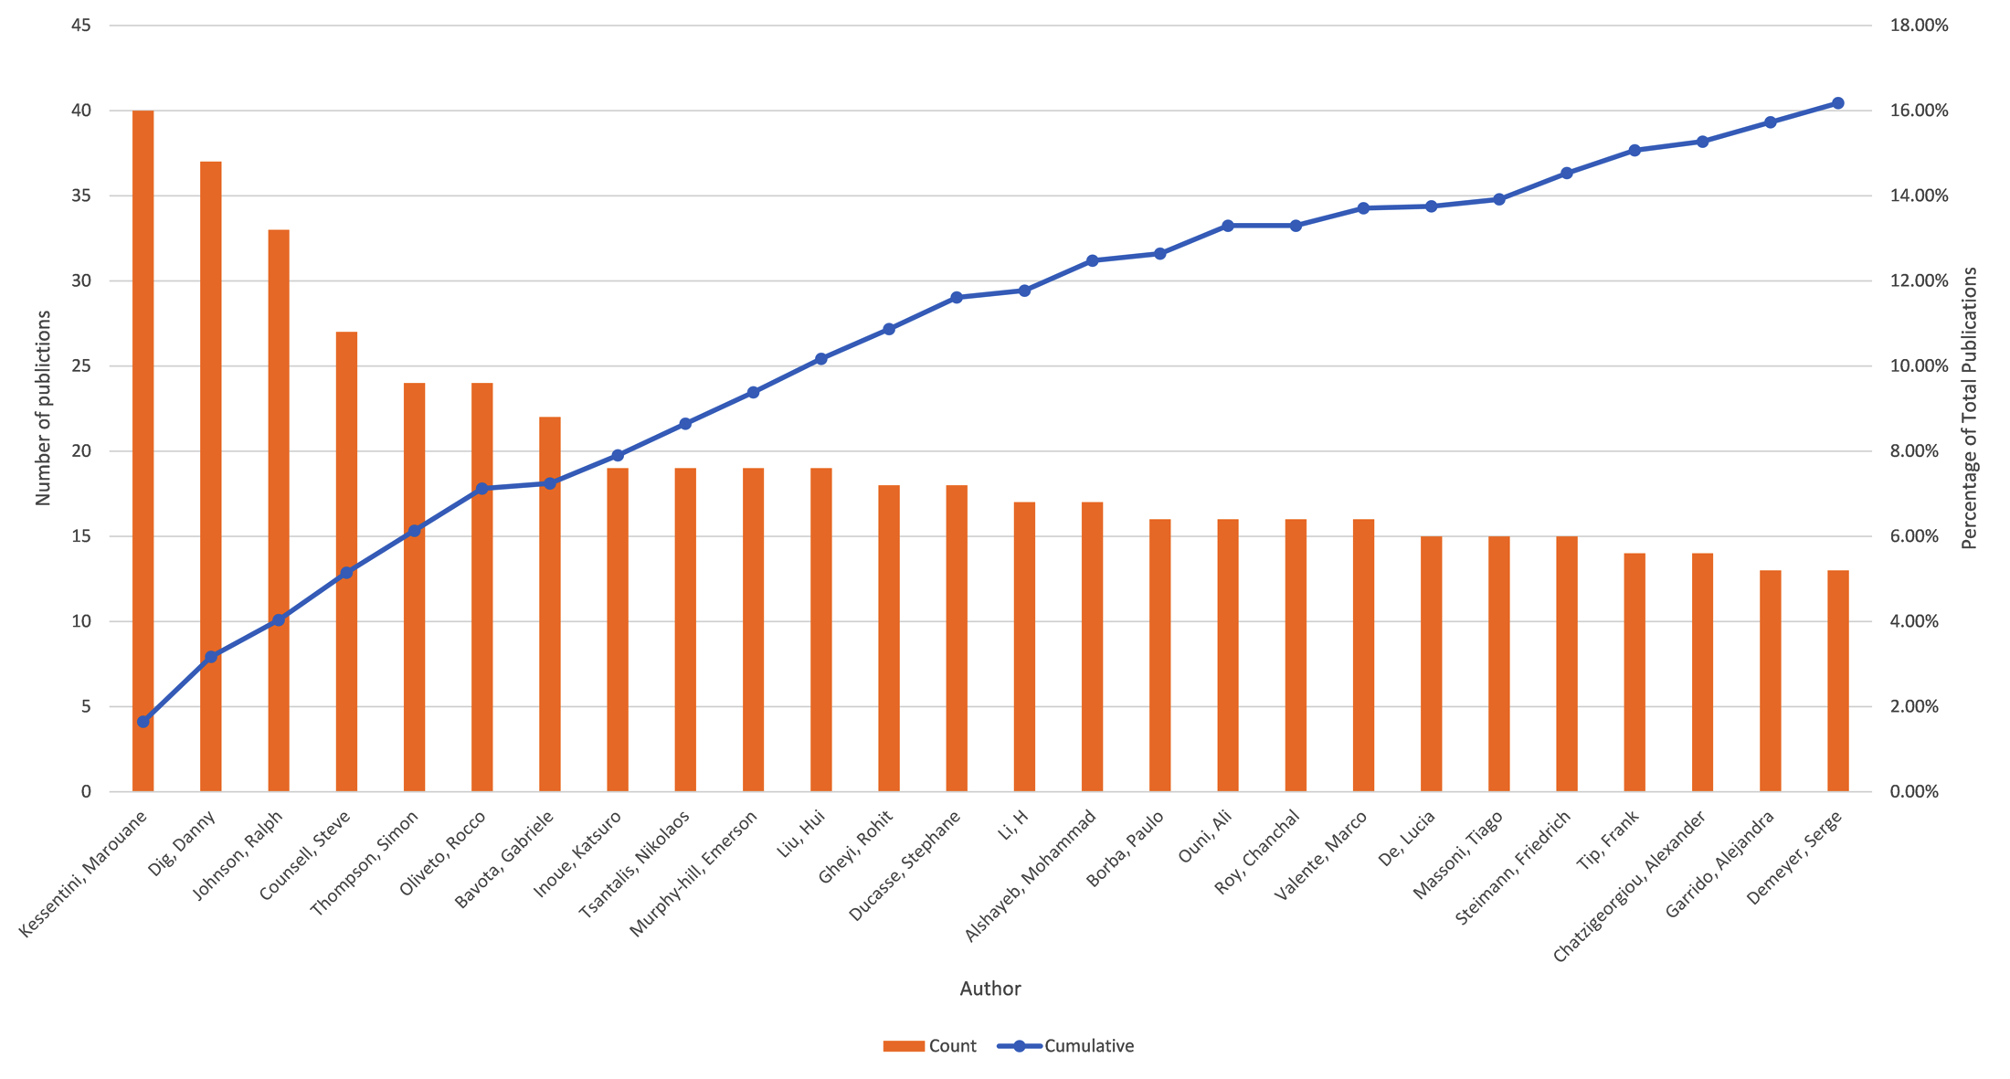
Who? The prolific authors
Notes:
The height of the bars is the number of papers published, and the blue line is the cumulative percentage of all refactoring papers published by authors from left up to that author
The Pareto distribution

Slide 51
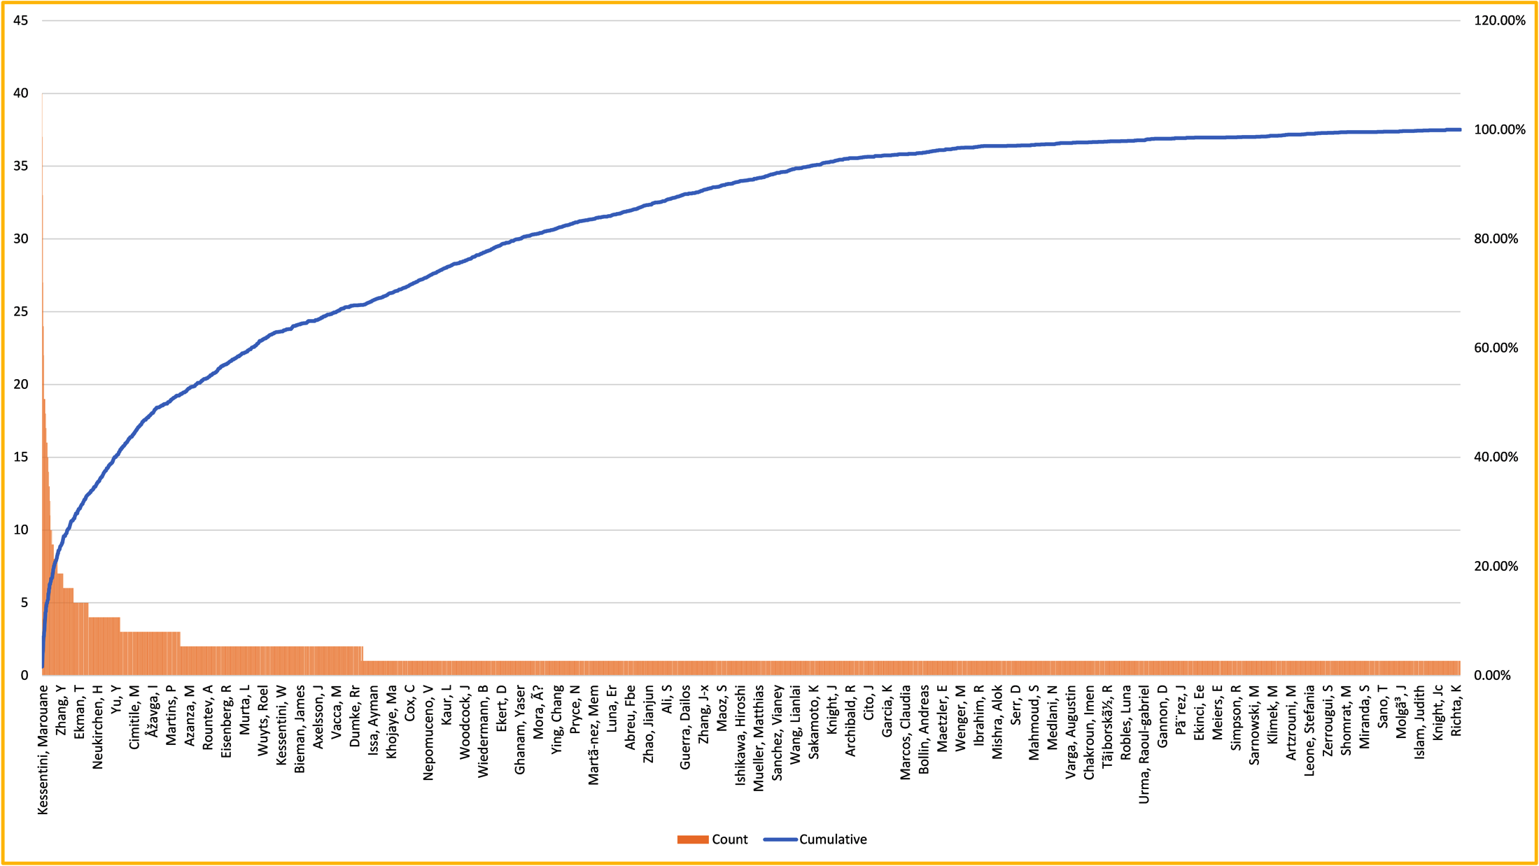
Who? Distribution of authors
23% of 4,944 authors published 68% of all papers
Notes:
Like the previous graph, this one now tabulates all the authors and the blue line shows their cumulative percentage of all papers.
A particular point of interest is this one: authors that published at least 2 refactoring papers. We call these authors ”repeated convicts” because they have been found guilty of publishing refactoring at least twice.
The Pareto distribution:
At least two papers: 1121 authors
23% of authors published 68% of all papers
33% of authors published 80%

Slide 52
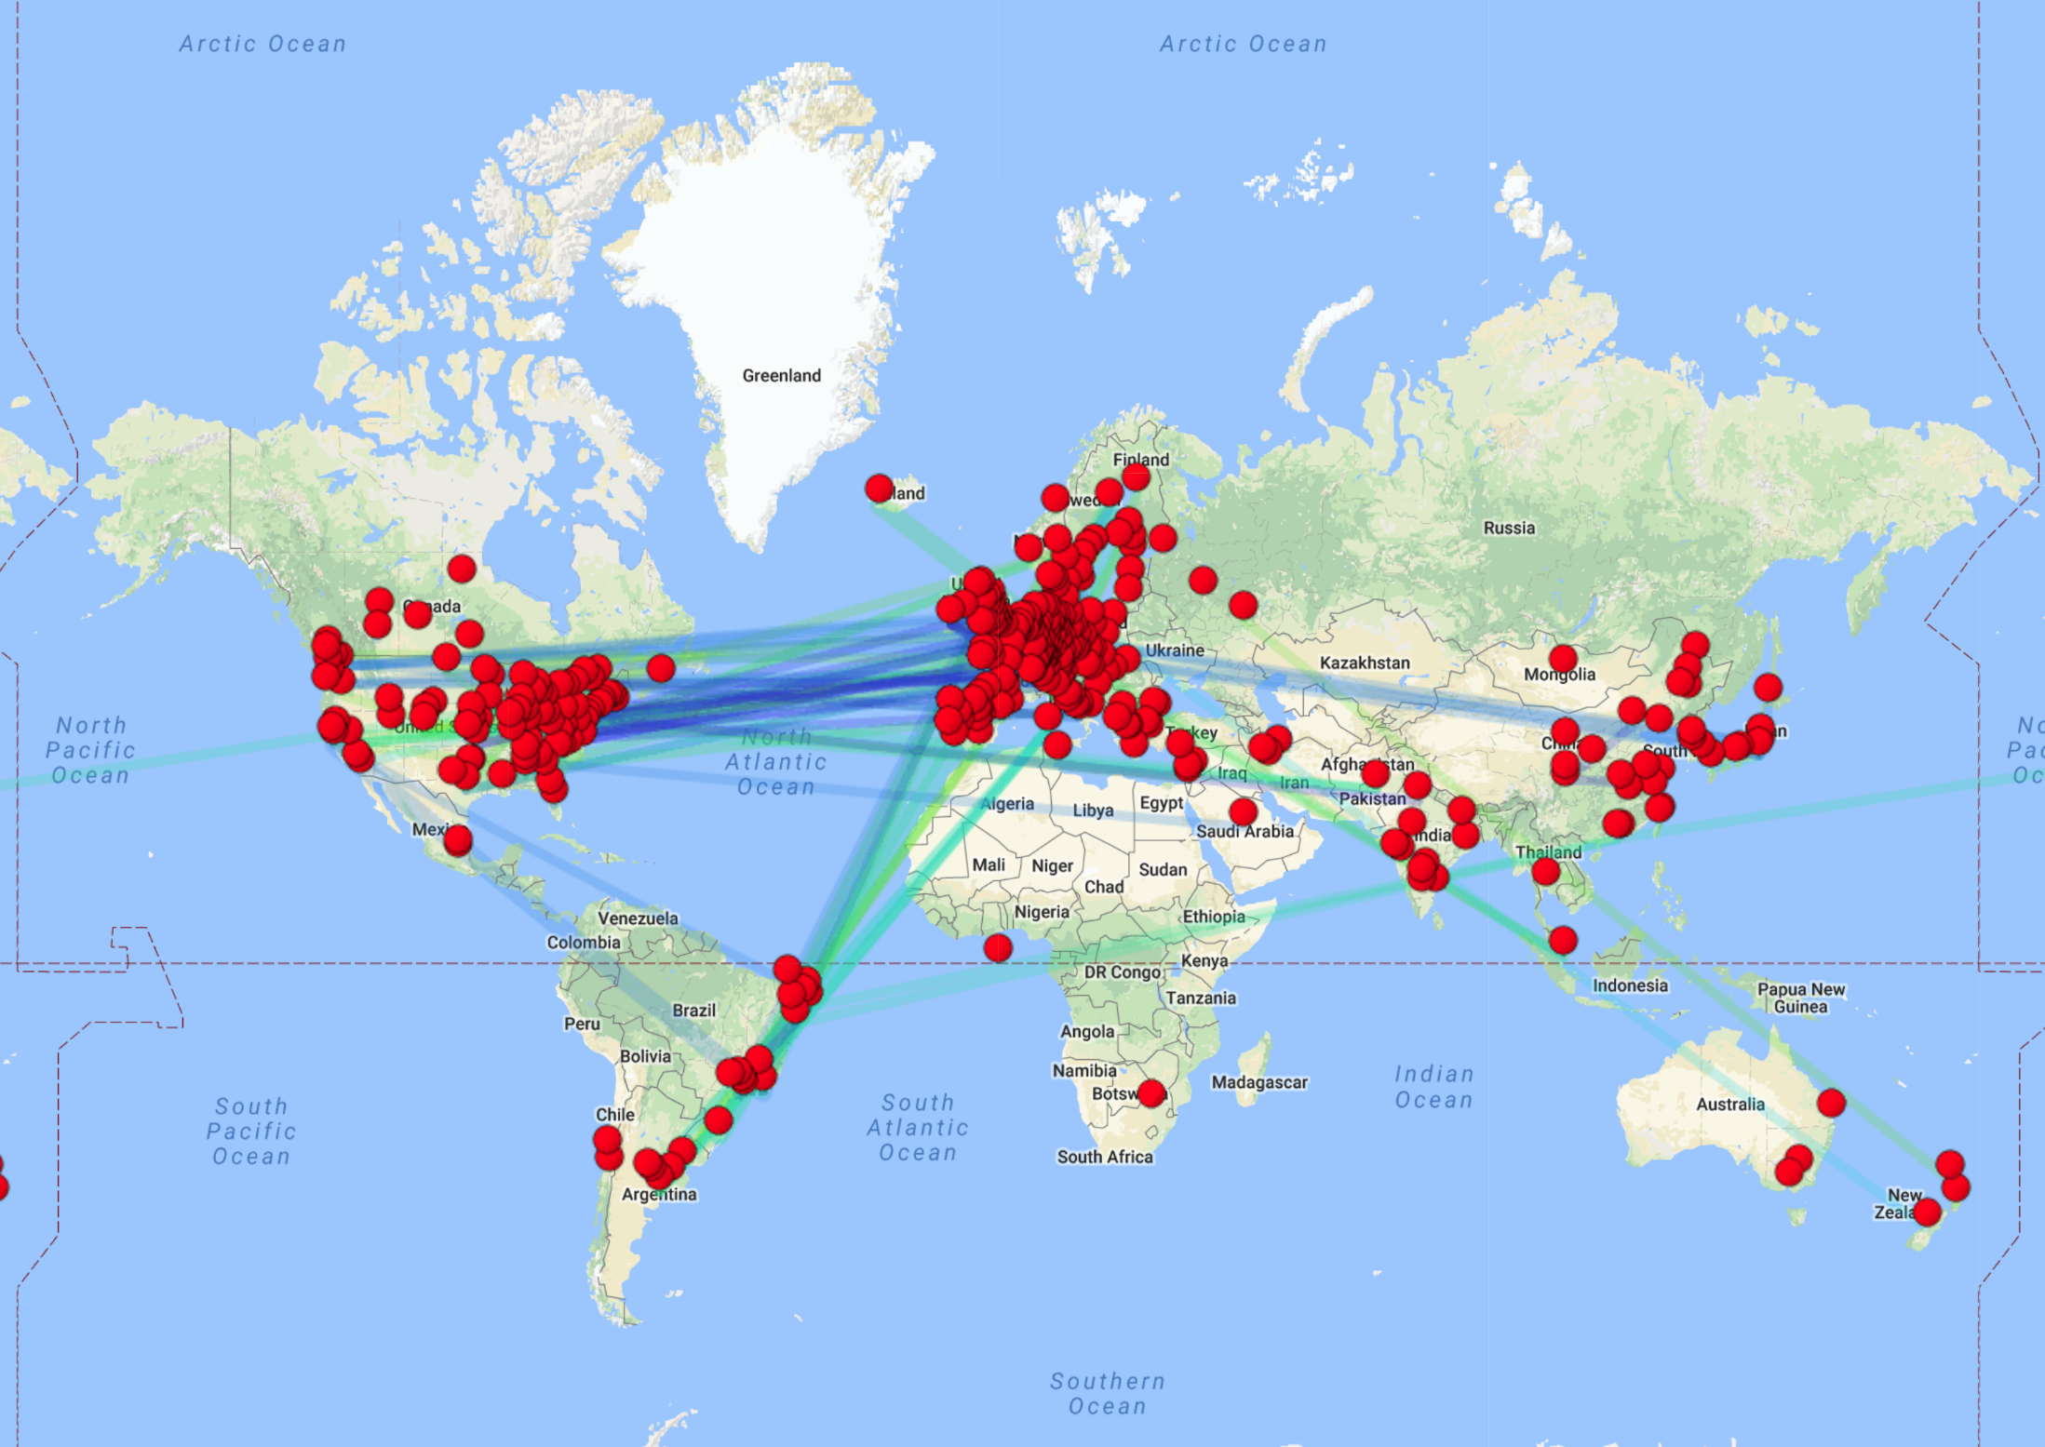
With Whom? Collaborations
Notes:
Fairly intense collaborations:
Expected to see lots of collaboration edges between US and Europe
Surprising to see Latin America working mostly with Europe

Slide 53
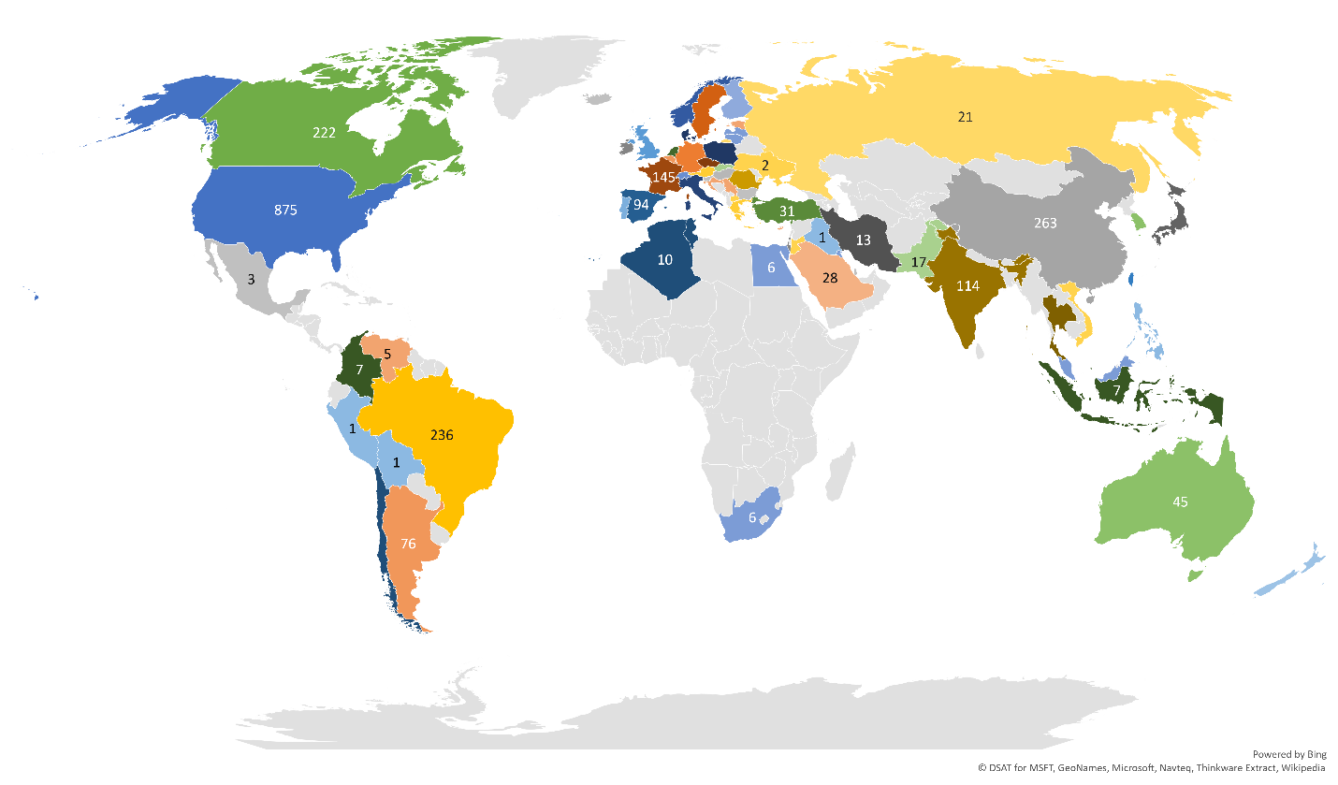
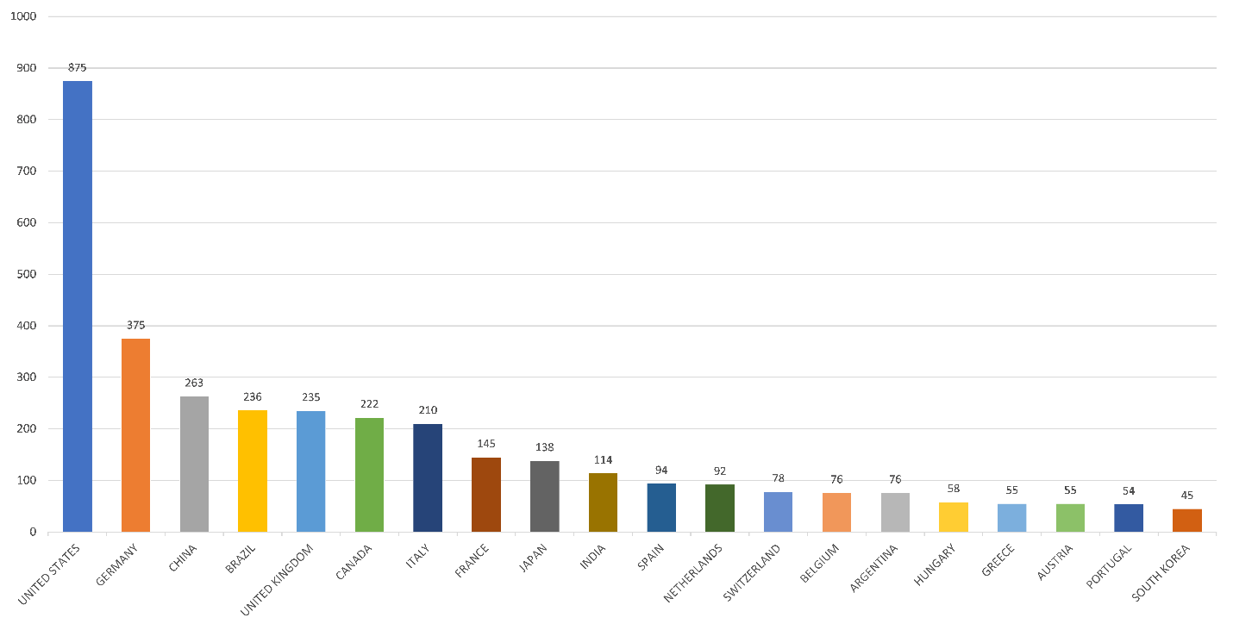
Where?
Notes:
US institutions
Germany
China
Surprising Brazil as the fourth most active.
UK
Canada

Slide 54
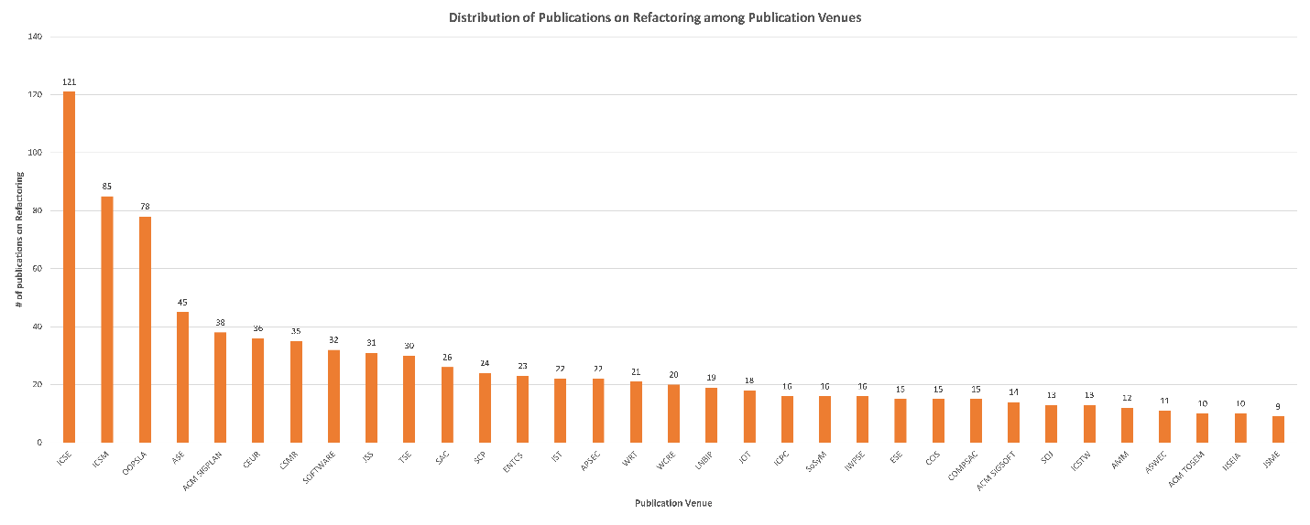
Where? Publication Venue
Notes:
Graph shows the major publication venues, and how many papers were published in that venue.
Surprising: FSE which is the other top SE conference along with ICSE is not where people publish refactoring

Slide 55
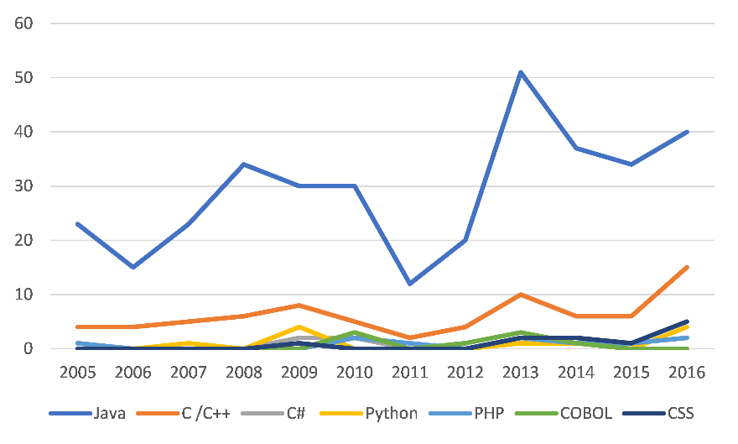
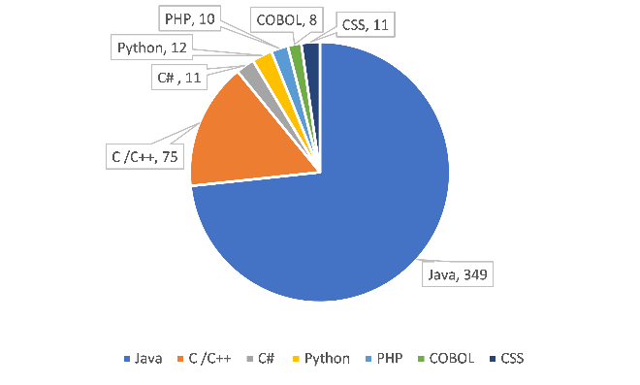
What? Target language
Java
C/C++
Web
Notes:
We see that Java dwarves all the other languages combined
on second rank we have C/C++ combined
Third rank we have a lot of web languages, CSS, Phython, PHP
CLICK
Contrast this with the Tiobe survey that shows the popularity of programming languages.
- Java is still the most popular language, but when we combine C and C++ they get on par with Java, and also when we combine all the Web languages out there they are comparable with Java.
Java is so popular because the availability of infrastructure and benchmarks and open-source code
Call for Action for more research on other languages, especially the languages for Web development

Slide 56
The Perils of Asynchronous Programming
modern
async
sync
async
Modernize legacy async code from call-backs to async/await
On some platforms, Microsoft no longer supports legacy async
Non-trivial changes: preserve program behavior and
even the order of exceptions
Notes:
However, refactoring code from a synchronous model to asynchronous is non-trivial.
Once arrived in the promised land of async programming, the app developer needs further refactoring.
Even code that is designed with asynchrony upfront still needs refactoring in order to remain useful.
CLICK
One example is modernizing legacy async code. This means replacing call-back style with modern async/await constructs such as the ones that Microsoft recently introduced in C#.
On some platforms, Microsoft no longer supports the legacy async models, forcing programmers to manually port legacy async apps.
These changes are non-trivial, as the programmer needs to preserve the original program behavior, the thread semantics, and even the order in which exceptions are thrown.
CLICK

Slide 57
The Perils of Asynchronous Programming
modern
async
sync
async
performant
async
Misused async constructs hurt performance,
cause deadlocks
4% of async code runs synchronously
Async code that constantly badgers UI kills responsiveness
by “a thousand paper cuts”
Notes:
Moreover, the programmer still needs to detect and fix async errors.
CLICK
We found several async errors which hurt performance and caused serious problems like deadlocks in top-rated apps.
In 4% of the top Android apps that we analyzed, we found code that appears to be asynchronous but still executes synchronously, in a blocking manner.
We also found async code that constantly badgers the UI thread with bits of work to do, thus killing responsiveness with the proverbial a thousand paper cuts
CLICK
Developers need to fix these async errors for the app to remain useful.

Slide 58
The Perils of Asynchronous Programming
modern
async
sync
async
performant
async
long-running
async
Short-running async constructs can lead
memory leaks, lost results, and wasted energy
Requires changing stateful into stateless code: from shared
memory communication to distributed style
Notes:
Another example is refactoring async code to handle long-running tasks.
CLICK
Innapropriate use of short-running async constructs to encapsulate long-running tasks can lead to lead to memory leaks, lost results, and wasted energy
This problem is widely discussed in app developer forums.
CLICK
In this case, the developer needs to change the code from stateful to stateless execution, by replacing communication through shared memory with a distributed style of communication through marshaling objects on special channels.
In all the scenarios I presented so far these refactorings are complex and error prone.

Slide 59
Overview of Our Transformations for Asynchronous Programming
modern
async
sync
async
performant
async
long-running
async
Notes:
Among these vectors of refactorings for improving responsiveness, we have automated some for different platforms (Android and Microsoft .NET) and for different programming languages (Java and C#).
(CLICK) But today I will only present one of these refactorings in more detail,
and will give a summary (CLICK) for the work we have done on the .NET

Slide 60

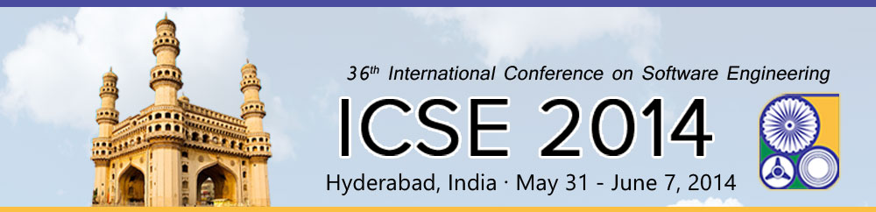
A Study and toolkit for asynchronous programming in C#
Semih Okur
David Hartveld
Danny Dig
Arie van Deursen
Notes:
I will shift gears now, and will move faster through another project.
This time I will present a formative empirical study and a toolkit for asynchronous programming in C#.
The idea came from my PhD student Semih, after he returned from one summer internship at Microsoft.
This is a collaborative project: David is a MS student from Delft University. David asked his advisor to let him do some research on refactoring, and Arie thought it's best to send David to work with my group for half a year.
We presented this paper at the International Conference on Software Engineering in 2014, where this paper received an ACM SIGSOFT Distingsuihed Paper Award

Slide 61
callback hell!
private void SnapAndPost ()
{
Busy = true;
UpdateUIStatus ("Taking a picture");
var picker = new Xamarin.Media.MediaPicker ();
var picTask = picker.TakePhotoAsync (new Xamarin.Media.StoreCameraMediaOptions ());
picTask.ContinueWith ((picRetTask) => {
InvokeOnMainThread (() => {
if (picRetTask.IsCanceled) {
Busy = false;
UpdateUIStatus ("Canceled");
} else {
var tagsCtrl = new GetTagsUIViewController (picRetTask.Result.GetStream ());
PresentViewController (tagsCtrl, true, () => {
UpdateUIStatus ("Submitting picture to server");
var uploadTask = new Task (() => {
return PostPicToService (picRetTask.Result.GetStream (), tagsCtrl.Tags);
});
uploadTask.ContinueWith ((uploadRetTask) => {
InvokeOnMainThread (() => {
Busy = false;
UpdateUIStatus (uploadRetTask.Result.Failed ? "Canceled" : "Success");
});
});
uploadTask.Start ();
});
}
});
});
}
Invert the control flow
Obfuscate the intent of the original synchronous code
Don’t scale to large programs
Notes:
Let’s look at some callback code from a real world application. You do not really need to read the code.
It is a method which only takes a picture and sends it to a server asynchronously.
Look at how complicated this method is. This method is still not complete, as it does not even contain exception handling code!!
(CLICK)
Basically callbacks invert the control flow and do not scale to large program.

Slide 62
async/await keywords
Special language constructs introduced in C# 5 (2012)
Make asynchronous programming a first-class citizen!
Possible to express efficient asynchronous code in a familiar direct style
async:method identifier
await:used to define pausing points
Notes:
To eliminate callback’s disadvantages, C# introduced special language constructs which are async and await.
These simplify asynchronous programming and make it a first-class citizen.
CLICK
When a method has the async keyword modifier in its signature, the await keyword can be used inside to define pausing points.
=====
async/await can only be used with New asynchronous operations which returns Task(like future abstraction in java).

Slide 63
our study
We do not know how developers use asynchronous programming in practice.
(ii) Asynchronous programming is hard to use and developers lack tool support for it.
Conducted a first large-scale formative study about asynchronous programming to answer two RQs:
Q1) How do developers use asynchronous programming?
Built Asyncifier, a refactoring tool.
Q2) Do developers misuse async/await?
Built Corrector, a bug fixing tool.
Notes:
Our motivation for this work came from the fact that we do not know how developers are using these new constructs in practice,
And second, we know that async programming is hard to use and developers need tool support
CLICK
Thus, we first conducted a large-scale formative study to answer two research questions.
CLICK
First, How do developers use asynchronous programming?
Based on the answer, we built a refactoring tool: Asyncifier.
CLICK
Second, do developers misuse async/await?
After answering the question and having the findings; we built corrector, a bug fixing tool.
I will start with answering Q1 and explaining Asyncifier.

Slide 64
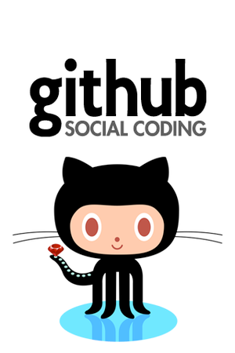
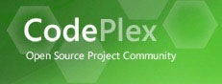
code corpus
Analyzed 1378 open source Windows Phone apps, comprising 12M SLOC, produced by 3376 developers.
Built a static analysis tool with Microsoft’s Roslyn
(C# compiler APIs: syntax, symbol, binding)
Notes:
To conduct the formative study, we analyzed 1379 open source Windows Phone applications from github and codeplex
they comprise of 12 millions source lines of code written by 3376 programmers.
<CLICK>
Of course, we did not manually analyze these apps, instead we built a static analysis tool
by using Microsoft’s Roslyn framework.

Slide 65

developers need a refactoring tool: asyncifier
Developers heavily use callback-based operations
Microsoft officially no longer recommends these operations
Refactoring from callbacks to async/await is non-trivial
We built ASYNCIFIER:
a refactoring tool to upgrade callback code to async/await
Notes:
We found that developers heavily use callback-based asynchronous operations.
CLICK
However, Microsoft officially no longer recommends these asynchronous operations and these operations are not available anymore in the new platforms such as
CLICK windows 8, microsoft surface.
So developers need to refactor callback-based operations to new ones that can take advantage of the async/await keywords.
CLICK
The problem is that the changes that the refactoring requires are tedious and non-trivial.
CLICK
For these reasons, we built Asyncifier, a refactoring tool to automatically upgrade asynchronous code from callbacks to async/await.

Slide 66
developers need a bug fixing tool: Corrector
Developers frequently misuse async/await keywords
We built Corrector:
a transformation tool to find and correct the misused async/await
Batch mode to fix existing mistakes
Quick fix (VS) mode prevents user from introducing mistakes
Notes:
It is very obvious that developers misuse the async/await a lot.
CLICK
To find and correct the misused async/await in the existing code, we built Corrector.
CLICK
Corrector works in two different modes. First, batch mode. It fixes all the async/await errors that it finds in a project.
CLICK
It also supports quick fix interactive mode for Visual studio. Corrector constantly scans the source code which is under edit, and highlights async errors as soon as the developer made one, and offers the transformation to fix it.

Slide 67
Empirical evaluation
Used the same code corpus from the Formative Empirical Study: 1378 WP apps, 12M SLOC
(EQ1) Are they applicable?
A: Yes, applied successfully on thousands of instances
(EQ2) What is the impact on productivity?
A: Each refactoring changes 29 LOC, non-trivial
(EQ3) What is the run-time performance?
A: < 2sec, suitable for interactive use
(EQ4) Do developers find the transformations useful?
Notes:
To evaluate Asyncifier and Corrector, we used the same code corpus from the Formative study.
We asked four evaluation questions.
CLICK
First, our tools applicable? The answer is a an empathically yes. We successfully applied them thousands of times
CLICK
Does automation improve productivity?
We found that on average, each refactoring changes 29 LOC, These changes are non-trivial, and would require a significant effort from programmers
CLICK
What is the runtime performance of our tools?
CLICK
as last, usefulness of the transformations.

Slide 68

Developers find Asyncifier & Corrector useful
Chose 10 most recently updated apps that have callbacks.
Applied Asyncifier ourselves and offered patches.
9 out of 10 apps responded and accepted 28 refactorings.
“That was pretty good, look forward to the release of refactoring tool, it seems to be really useful.” Ocell app
Chose 20 most recently updated apps (where we found async err)
All apps accepted all our 288 instances of Corrector transformations
"What you have pointed out is correct. This time, performance has been improved by 2x.” Softbuild.Data app
CORRECTOR ships now with official release of
Notes:
To evaluate the usefulness in practice,
we applied the tools ourselves and offered the transformations to the developers as patches.
For asyncifier, we chose 10 most recently updated apps that have callbacks.
Then, 9 out of them responded and accepted all 28 refactoring instances.
We also received very positive feedback on these patches.
CLICK
Ocell, which is a twitter app, is looking forward to the public release of the refactoring tool, and thinks that the tool is useful.
Responses like these show the demand for refactoring tool support from callbacks to async/await
CLICK
Then we did the same thing for corrector. In this case, we choose 20 apps which have anti patterns After offering the patches, all of them responded and accepted all 288 instances of corrector transformations.
We again received very positive feedback.
CLICK
The developers experienced performance improvements after removing unnecessary async/await keywords.

Slide 69
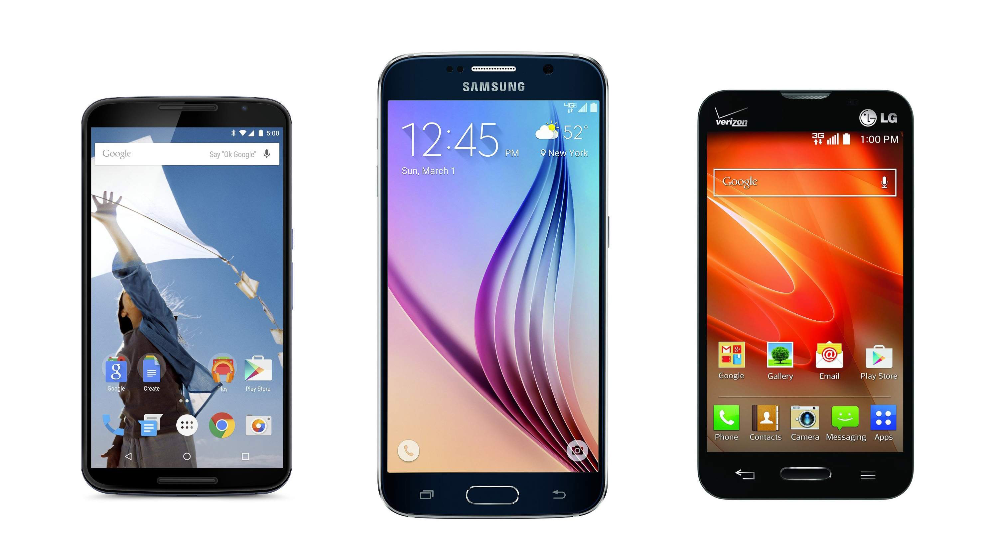
Mobile Devices are Everywhere
300B apps downloaded annually [Gartner]
Most end-users spend most of their time on mobile devices
Q: What is the next Killer Feature for mobile computing?
Notes:
The mobile domain has seen a huge growth.
Gartner said that in 2016 more than 300 Billion apps have been downloaded.
But I think the untapped potential of mobile is still ahead of us.
<CLICK>
ASK: If you can envision a killer feature that mobile devices can do for you in the future, what would this be? For a minute, let your imagination run loose and dream about the future.
Go to next slide and type down their answers.
TODO: repeat their message back: so what I hear you saying is that you wished you had a personal assistant who would help you do X…

Slide 70
Intelligent Personal Assistant
Remember names
Activity-based reminders
Scheduling for busy people
Information sharing
Interfacing with Smart City
Notes:
Let me describe one killer feature which I call: Intelligent Personal Assistant.
Imagine that you were rich and you could afford to hire a butler that would do all kinds of tasks for you.
Here is one example: the butler would remind you of people you met. I go to several conferences or events, likewise many of you go to many parties, and I meet new people. A few years later I run again into the same person, and I have a feeling that I met this person before, but I no longer remember when/where/and what we talked about. The Mobile Intelligent Personal Assistant tells me who this person is, and where we met and what conversations we had.
Here is Another example: The butler would give me very useful reminders. These reminders are not based simply on a time or location, but the context is based on the activity I am doing: next time when I see Caius, remind me to ask him about a topic we should discuss at the TA meeting. Next time when I dress, remind me to wear this other shirt.
Here are other examples that show the Intelligent Assistant is proactive:
CLICK
Scheduling: for busy families: who needs to be where and when, so that we can get kids to places on time. You can tell it preferences but it also discovers preferences.
CLICK
Information sharing; I want to share the document with all the people in the room: the assistant should know who is in the room
In the not-so-distant future of Internet of Things, Think about the Butler as the interface between the end-user and the Smart city. Here are some examples.
- you are invited by a friend to go to dinner to Hillsborough and you are told they will serve lasagna as the main course. The Intelligent Personal Assistant recommends: on your way to Hillsborough, stop by at this XYZ wine show and buy this Pinot Noir that goes well with Lasagna. And by the way, if you drive along this particular route not only that you save time, but you also can pick up these flowers from ABC Floral Shop (to go well with the wine).

Slide 71

Enabling Research Thrusts
Security & Privacy:
Software Security
Cloud:
Systems
Energy Efficiency:
PL, SE
Intelligence:
ML, AI, NLP
Evolution & Testing:
SE
Usability:
HCI, PL, SE
Notes:
Here are some of the big technical research thrusts that we need to have in place:
first, is the Intelligence part. Expertise on this area will come from our amazing ML and AI experts
Security and Privacy: If this Intelligent Buttler is Listening to everything I say, and remembering people I meet, it better be Secure.
Cloud: heavyweight compute but also for storage: Expertise from Systems.
Energy Efficiency: The intelligent assistant should not drain my phone battery in an hour. Expertise from PL, SE.
Usability: both in terms of the end-users so that the assistant can be used by people that do not hold a PhD degree, but also better usability of programming models. Expertise from HCI, PL, SE
Software Engineering: what are the programming models so that app developers can leverage access to Intelligent Assistants? How do we cope with the drastic evolution of the platform? How do we test such systems?
Let me dig deeper into one single area that is the most closely related to the topic of this class: Software Evolution.

Slide 72
Overview of My Research
Mobile
Parallelism
Automating
Inferring
program analysis
+ Information Retrieval
+ data mining
Interactive Analysis &
Transformation
Libraries
End-user
Archiving &
Retrieving
Understanding
-user-centered research
-history at higher-levels of abstraction
Testing
- generate test suites
Notes:
Beyond automating program transformations,
CLICK
I have also worked on automatic inference of transformations from low-level text edits. To make this accurate and scalable, I combined static analysis with techniques from information retrieval and data-mining such as frequent itemset mining.
CLICK
To ensure the safety of program transformations, I automated the testing of program transformations. We generated test suites for complex transformations, or for detecting errors in manual transformations.
CLICK
In the area of archiving and retrieving transformations, I have developed the world’s first refactoring-aware version control system. It makes it easier to understand program evolution by showing history in terms of higher-level transformations.
CLICK
In order to discover what are the common changes in practice, I have conducted several formative studies. They help me understand what people are doing, what they think they are doing, and what they are not really doing, and use triangulation on these answers to determine what we need to automate.
CLICK back and forth
Today I only have time to present some of the software changes that we automated for mobile apps.

Slide 73






Industry Partners
studies on proprietary code
joint publications
funding
Notes:
I value having close interactions with industry.
Since coming to OSU I have been intentionally targeting and partnering with local Oregon companies:
CLICK Such as Nike, WebMD and Intel
But the move to the West Coast also enabled me to work closely with our neighbors just north of us CLICK (Microsoft). For example, the research that I presented earlier on .NET we worked closely with the .NET library designers.
I also worked with companies just south of Oregon CLICK
I keep working with distant companies too. CLICK
CLICK
Our industrial partners :
Provide large, proprietary code bases that we use during the formative stage but also evaluation of our research,
publish with us
And they also fund our work
For example, now I am working with Google on security refactorings that upgrade to the latest permission model for Android apps. This makes apps more resilient to exploits. This work could only happen by having access to Google’s professionally written Android apps, and technical meetings with the designers of the new permission model in Android.

Slide 74

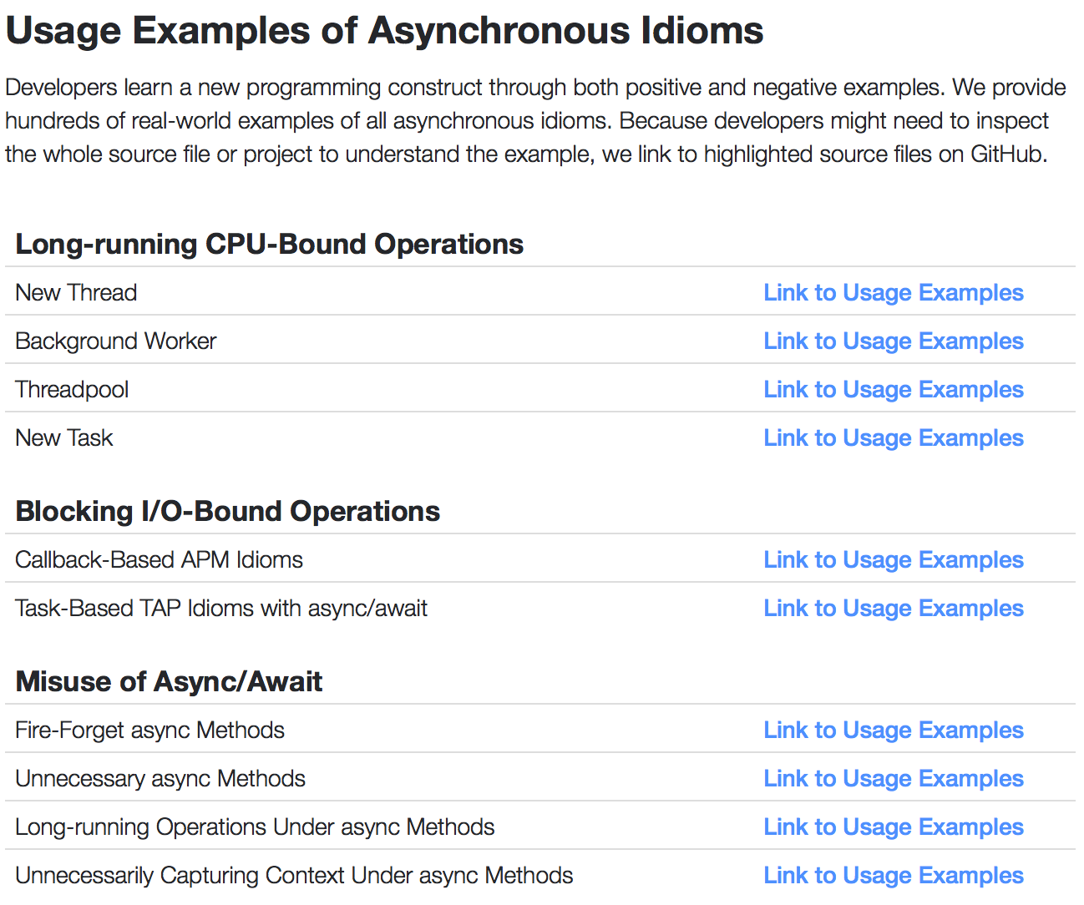
implications
Developers
LearnAsync.NET: hundreds of real-world positive and negative examples of asynchronous idioms
Notes:
Besides the tools, Asyncifier and Corrector; we also provide a tremenduous portal, learnasync.net.
Where developers can inspect hundreds of real-world examples of all asynchronous idioms and learn from both positive and negative examples.

Slide 75
My Research Approach
Build tools: automation shows we formalized concepts
Rigorously employ empirical methods during evaluation
and formative stage
Connect seemingly unrelated areas and make novel contributions (e.g., design scalable program analyses using data-mining techniques)
Committed to move my research into practice
Devise theories that generalize to solve larger classes of problems, principles for changing programming models
Notes:
I want to present my philosophy for conducting research in software engineering.
I am an experimentalist and I build tools. Tools are important to software engineering research, both practically, in that they aid developers in a tedious, error-prone activities, and theoretically, in that the automation serves as a proof that the concepts have been sufficiently formalized to be executed by a computer.
As Commonly done in software engineering research, I rigorously employ empirical methods (e.g., case studies, controlled experiments, interviews) in the evaluation stage (did we built the tool right?)
However, I also Employ empirical methods in the formative stage of the research (are we building the right tool?). I place high value into first understanding what people are doing, what they think they are doing, and what they are not really doing, and use triangulation on these answers to determine what they need.
I enjoy connecting seemingly unrelated areas of computer science and make novel contributions for example, designing scalable program analyses using data-mining techniques)
I happily go the extra mile necessary to move my research into practice. I maintain strong ties with the industry groups building the major integrated development environments (IDEs), and I contribute to open-source software.
My research advances science by discovering generalizable knowledge about the applicability of transformations as an effective paradigm for software evolution.
And I discover principles for changing programs between significantly different programming models, both in terms of the control-flow (from synchronous to callback-based, from sequential to parallel) and program state (from shared- to distributed- memory style of communication and from statefull to stateless execution)

Slide 76
Overview of My Research on Automating Transformations
Convert & fix async for mobile
Automating
Retrofit parallelism
ASE15, SOFTW’15,
ICSE14, FSE14
Interactive Analysis &
Transformation
TOSEM15,STVR15,
ECOOP14,ISSTA13,
FSE13,ICST13,FSE12,
ICSE11,SOFTW11,
OOPSLA09,
ICSE09, ASE09a
Upgrade library-based
programs
Refactor end-user software
ECOOP13,ECOOP12,
TSE08, ICSE08, ICSE07,ECOOP06,
JSME06,ICSM05
FSE14d,ICSM12
Notes:
Today I only had time to talk about interactive analysis and transformations for asynchrony on mobile devices.
Following a similar trajectory, in the past I successfully pioneered interactive program analysis & transformations by opening the field of refactoring in other novel domains:
CLICK
We change existing sequential programs to make them run in parallel, and change data structures to make them thread-safe,
These changes are crucial in the multicore era when programmers need to resort to parallelism to improve performance.
CLICK
Upgrade library-based applications to use the latest API of their libraries,
CLICK
(iii) Improve performance and maintainability of end-user software (e.g., spreadsheets).
CLICK
If we combine all this work under one single label, it would be called automating program transformations
=========
DON’T Read this For example, the novel static analysis techniques that we developed for race detection in parallel code we extended
To determine non-interference of asynchronous operations even in the challenge posed by
event-driven systems and callbacks.

Slide 77
Overview of My Research
Mobile
Parallelism
Automating
Inferring
ICSE14c,ECOOP13,
ASE09a,ECOOP06
Interactive Analysis &
Transformation
Libraries
End-user
Archiving &
Retrieving
Understanding
ICSME15, ECOOP12,
FSE12, IWMSE11,
JSME06, ICSM05
TSE08, ICSE07
Testing
ICST13, TSE10, ASE09b,
ISSTA08, FSE07
Notes:
Beyond automating program transformations,
CLICK
I have also worked on automatic inference of transformations from low-level text edits, and inferring code annotations for safe parallelism.
CLICK
We also have good results in the area of testing program transformations, for example by generate test suites for complex transformations, or for detecting errors in manual transformations.
CLICK
In the area of archiving and retrieving transformations, I have developed the world’s first refactoring-aware version control system. It automatically resolves more merge conflicts than traditional text-based systems (e.g., CVS or SVN), is able to retrieve and track history of program elements no matter how much they were refactored, and makes it easier to understand program evolution by showing history in terms of refactorings.
CLICK
In order to understand what are the common changes, I have conducted several empirical studies.

Slide 78
Challenge #1: What May Execute in Parallel in the Context of Event-Driven
class RouteselectActivity extends Activity {
public void onCreate() {
new AsyncTask() {
void doInBackground(…){
…
mCsr = db.rawQuery(query);
}
}.execute();
…
if (mCsr.getCount() == 0) return;
}
}
button.setOnClickListener(
new OnClickListener(){
public void onClick() { … }
}
});
Other event handlers
Instructions after launching AsyncTask
Notes:
First, the analysis needs to determine what may execute in parallel with the async operation.
For this, we use an approximation of the happens-in-parallel relation induced by AsyncTask.
CLICK:
in this example, we need to determine what other instructions can happen in parallel with those in the doInBackground.
CLICK
First, the instructions that exist in the original method after it launched AsyncTask
CLICK
Other event handlers that can be processed non-deterministically by the UI Thread.

Slide 79
Developers find Asyncifier useful
Chose 10 most recently updated apps that have callbacks.
Applied Asyncifier ourselves and offered patches.
9 out of 10 apps responded and accepted 28 refactorings.
“That was pretty good. look forward to the release of refactoring tool, it seems to be really useful.” Ocell app
“You are doing very interesting stuff. That's fortunate, because
I've been thinking about replacing all asynchronous calls to new
async/await style code” phoneguitartab app
"That’s very interesting and useful.” 32feet app
Notes:
To evaluate the usefulness in practice,
we applied the tools ourselves and offered the transformations to the developers as patches.
For asyncifier, we chose 10 most recently updated apps that have callbacks.
Then, 9 out of them responded and accepted all 28 refactoring instances.
We also received very positive feedback on these patches.
CLICK
Ocell, which is a twitter app, is looking forward to the public release of the refactoring tool
The developers of phoneguitartab : said “that’s fortunate because i’ve been thing about replacing all asynchronous calls to new async/await style code”.
CLICK
These responses show the demand for refactoring tool support from callbacks to async/await

Slide 80



(4) Developers find Corrector useful
Chose 20 most recently updated apps (where we found async err)
All apps accepted all our 288 instances of Corrector transformations
“This is awesome insight! Great work!” indulged-flickr app
"Thanks for your great advice. You are right, the async/await
keywords could be removed” kanboxwp app
"Totally agree, I normally try to take the same minimizing approach,
though it seems I missed these. Thanks!” Cimbalino app
"That you have pointed out is correct. This time, performance has been improved by 2x.” Softbuild.Data app
Notes:
Then we did the same thing for corrector. In this case, we choose 20 apps which have anti patterns
After offering the patches, all of them responded and accepted all 288 instances of corrector transformations.
We again received very positive feedback.
CLICK
One said that “this is awesome insight. great work”
CLICK
CLICK
CLICK
please have a look at the last one. The developers experienced performance improvements after removing unnecessary async/await keywords.
it is great to read such feedback from the developers.

Slide 81
Preconditions of the Transformation
P1: The selected code does not write to more than one variable which is read after the selection
P2: The selected code should not contain return statements
P3: The selected code contains only entire statements
i.e., it cannot be an expression or variable
Notes:
before transforming the code, Asynchronizer ensures the following three preconditions hold on the input program. These are not limitations of our tool, but are imposed by the Java language.
CLICK
The selected statements do not write to more than one variable which is read in the statements after the selection. Such a variable needs to be returned by doInBackground, but Java methods can only return one single variable.
CLICK
The selected statements should not contain return statements. A return statement in the original code enforces an exit point from the enclosing method. However, the same return statement extracted into an AsyncTask can no longer stop the execution of the original method.
CLICK

Slide 82

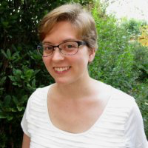

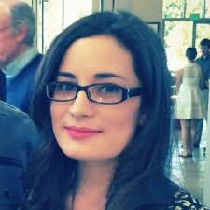

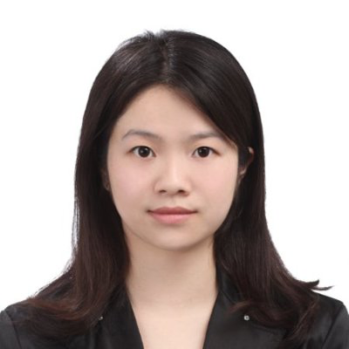
My Most Important Investment
PhD’13,
Lily Mast (Summer’15 - current)
Elias Rademacher (Summer’15 - current)
Nicholas Nelson (Summer 2014-15)
Sean McDonald (Summer’14 –Fall’15)
Hugh McDonald (Summer’14 – Fall’15)
Alexandria Shearer (Summer’12)
Kyle Doren (Summer’12)
Lyle Franklin (UIUC, Summer’12)
Alex Gyori (UIUC, Summer’12)
Yuwei Chen (UIUC, Spring 2012)
Anda Bereckzy (UIUC, Fall’11-Spring’12)
Alex Sikora (UIUC, Fall’11)
Jack Ma (UIUC, Summer’11)
Lorand Szacaks (UIUC, Summer’11)
Caius Brindescu (UIUC, Summer’11)
Mihai Codoban (UIUC, Summer ‘11)
Mihai Tarce (UIUC, Summer’09)
Cosmin Radoi (UIUC, Summer’09)
John Marrero (MIT, Spring’08 – Summer’08)
Stas Negara, PhD 2013, now at
Yu Lin (PhD 2015, now at Google)
Semih Okur (PhD 2016, now at Microsoft)
Michael Hilton (PhD)
Nick Nelson (PhD)
Tom Dickens (PhD)
Sruti Srinivasa (PhD)
Denis Bogdanas (postdoc)
Shane McKane (MS)
Mihai Codoban (MS 2015, now at )
Kendall Bailey (MS 2015, now at Intel)
Sandro Badame (MS 2012, now at Google)
Cosmin Radoi (MS 2013, now PhD student UIUC)
Fredrik Kjolstad (MS 2011, now PhD student MIT)
Binh Le (MS 2009, SW developer)
Can Comertoglu (MS 2009, now at Microsoft)
PhD’16
MS’15
Notes:
While I enjoy building novel tools, I value even more building people and investing myself into people.
Today I highlighted some of the PhD dissertations of Yu Lin, who is now at Google, and Semih Okur who is now at Microsoft
My Master students also have done great work. Each one of 8 MS students has published a paper with me. I inspired half of them to continue with a PhD program.
Among the 19 undergrads that have done research with me, 9 are now in grad school.
My passion is to help my students maximize their potential and inspire them to become tomorrow’s leaders.

Slide 83
My Most Important Investment
Stas Negara, PhD 2013, now at
Yu Lin (PhD 2015, now at Google)
Semih Okur (PhD 2016, now at Microsoft)
Michael Hilton (PhD)
Nick Nelson (PhD)
Tom Dickens (PhD)
Sruti Srinivasa (PhD)
Denis Bogdanas (postdoc)
Shane McKane (MS)
Mihai Codoban (MS 2015, now at )
Kendall Bailey (MS 2015, now at Intel)
Sandro Badame (MS 2012, now at Google)
Cosmin Radoi (MS 2013, now PhD student UIUC)
Fredrik Kjolstad (MS 2011, now PhD student MIT)
Binh Le (MS 2009, SW developer)
Can Comertoglu (MS 2009, now at Microsoft)
Lily Mast (Summer’15 - current)
Elias Rademacher (Summer’15 - current)
Nicholas Nelson (Summer 2014-15)
Sean McDonald (Summer’14 –Fall’15)
Hugh McDonald (Summer’14 – Fall’15)
Alexandria Shearer (Summer’12)
Kyle Doren (Summer’12)
Lyle Franklin (UIUC, Summer’12)
Alex Gyori (UIUC, Summer’12)
Yuwei Chen (UIUC, Spring 2012)
Anda Bereckzy (UIUC, Fall’11-Spring’12)
Alex Sikora (UIUC, Fall’11)
Jack Ma (UIUC, Summer’11)
Lorand Szacaks (UIUC, Summer’11)
Caius Brindescu (UIUC, Summer’11)
Mihai Codoban (UIUC, Summer ‘11)
Mihai Tarce (UIUC, Summer’09)
Cosmin Radoi (UIUC, Summer’09)
John Marrero (MIT, Spring’08 – Summer’08)
Notes:
While I enjoy building novel tools, I value even more building people and investing myself into people.
I have already graduated 2 PhDs, and the third is about to graduate soon.
I am currently supervising 5 PhD students and 1 postdoc. In the past I graduated 8 Master’s students (all published a paper with me). I inspired half of them to continue with a PhD program.
Among the 19 undergrads that have done research with me, 9 are now in grad school.
My goal is to help my students maximize their potential and inspire them to become tomorrow’s leaders.
Todo: put logos for companies
TODO: put pictures of students

Slide 84
(EQ1) our tools are highly applicable
54% of 1245 callbacks passed the preconditions.
Asyncifier refactored 54% of callbacks.
We manually verified that 10% of the instances are correct.
The reasons for un-refactored 46% of 1245 callbacks:
(i) Algorithm’s preconditions
(ii) Tool limitations
Corrector fixed 4 main types of anti-patterns (2209 instances)
Our tools can be applied to any platform written in C# (not only Windows Phone)
Notes:
To evaluate the applicability, we executed Asyncifier over the code corpus.
54% of 1245 callbacks passed the preconditions and all of them are refactored.
We manually verified that 10% of the instances are correct.
The main reason of the unrefactored 46% of the callbacks is the preconditions.
it is not possible to refactor most of them without changing the semantics of the original program.
CLICK
Second, we also applied Corrector to the full corpus and fixed 2209 antipattern instances.
(click)
It is also important to note that asyncifier and corrector work for any platform written in C#.
With such results, we conclude that the tools are highly applicable.

Slide 85
(EQ2) Automation is needed
Asyncifier changes 28.9 lines on average per refactoring!
(EQ3) Our tools are efficient
Asyncifier takes 508ms on average per refactoring
Corrector takes 47ms per transformation
suitable for an interactive usage in an IDE
Notes:
To evaluate the impact of the refactorings on the code we investigated the size of the changes.
CLICK
On average, ASyncifier changes 29 lines per refactoring, however, these changes are non-trivial.
This shows that automation is needed
CLICK
Third, we calculated the performance.
Both tools take under a second on average per instance.
CLICK
This shows that both tools can be used interactively in an IDE

Slide 86
Future Work: Change-Oriented Programming Environment
Enable a software revolution similar with the industrial revolution
Semi-automated transformations at center of software development
View programs as a composition of transformations
Enable programmers to write, script, modify, and replay transformations
NSF already funded this vision with $2.2M collaborative grant, I am the lead PI
Notes:
I the medium term future, want to enable a software revolution similar with the one in the industrial revolution era,
from manual development to semi-automated development of software.
By placing transformations at the center of software development, My research aims to (a) change the way people program, (b) create a platform for research for the next 10 years, and (c) produce results that become standard software development practice in 15 years.
I want programmers to think about programs as compositions of transformations, and for tools to infer the higher-level transformations from their lower-level edits.
I want both average and expert programmers to be able to write, script, modify, and replay their own transformations.
NSF already funded this vision with a $2.2M collaborative grant, of which I am the lead PI
With this, I know that my time is up, and I want to take questions now.

Slide 87
Change-Oriented Programming Environment http://cope.eecs.oregonstate.edu
Automating
Inferring
First-class
Program
Transformations
-unknown, frequent,
online
- static & dynamic
Scripting custom
transformations
Composing
Algebra:
commutativity
distributivity
conflict
dependency
Understanding
- perceive, recall, communicate change
Archiving/Retrieving
integrate with version control
Notes:
So far we have focused on refactorings, but in the future we want to treat similarly any kind of changes (including fixing bugs, performance optimizations, security, tests, adding features). Our environment called COPE will the first development environment that treats transformations intelligently, as first-class citizens, enabling programmers to express their programming tasks as program transformations.
Automating program transformations is a lot of hard work. This discourages people from creating new transformations. We must make this simpler. COPE will provide better ways for average programmers to quickly script their own transformations and for experts to implement sophisticated transformations.
---Experts are happy to learn about AST pattern-matching, AST substitutions, and program analysis.
For average programmers, Writing a transformation should be a simple exercise in writing Java methods
Composing: transformations are truly first class, when they become higher-order, that is we can transform the transformations. We will defined a rich algebra of transformations with properties such as commutativity, conflict, dependencies, parameterization—is central to transformation’s analysis and reuse. Programmers should be able to take a sequence of transformations representing an optimization or feature or bug fix, and reapply it to different versions of a program or even completely different programs. I will develop novel approaches to manipulate transformations as well as visualize their effects.
Infer transformations. We will develop an infrastructure within COPE to infer higher-level changes (e.g., bug fix, security improvement) from lower-level changes, especially code edits. This will allow us to capture high-level program transformations even when the programmer did not specify them.
We will develop a general framework that combines static and dynamic program analysis. We will also use techniques from machine learning and data mining techniques, so now I officially sent out a Call for Collaborators
Archive and retrieve transformations. The history of a program will be recorded at many levels of abstraction; as a sequence of low-level edits to text files as a sequence of operations on abstract program representations, as a sequence of programming tasks (bug fixes).
COPE will have a UI for searching, filtering, and grouping changes.
Understand transformations. COPE must not only model software as a sequence of transformations, but also use a sequence that programmers will understand and find usable.
We will conduct user research to better understand how programmers perceive, recall, and communicate change in complex code.
This project was recently funded by NSF, and I am the lead PI. To be useful, COPE will provide novel visualizations techniques. This means plenty of opportunities for collaboration with the HCI people at NCSU.

Slide 88

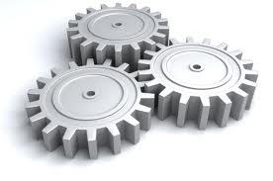
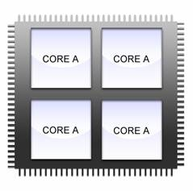
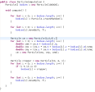
Interactive Source-to-Source Program Transformations
domain
knowledge
search, remember, compute
Programmer + Tool >> Tool | Programmer
Notes:
When it comes to making changes to our programs, we have two extremes:
- at one extreme we have the programmer alone: he has domain knowledge, but he manually and slowly changes very large programs that contain millions of lines of code.
- at the other extreme we have fully automatic tools like the compilers, which have been one of the biggest success stories in software automation.
Compilers take our programs written in a high-level programming language and transform them into machine level, executable code. Compilers perform all sorts of optimizations using sophisticated program analyses like control, data-flow, and pointer analyses. But compilers cannot fix broken object-oriented design, compilers are good at vectorization but not so good at coarse-level parallelism. There are things that a programmer knows that a compiler doesn’t, and there are things that need to be fixed in source code rather than in object code.
My approach on automating transformations is filling up the gap right here in the middle: it augments the sophisticated program analysis of the compiler with the strengths of the programmer and his insights, in a unique blend of interactive source-to-source program transformations.
I conjecture that this unique interleaving of the programmer+interactive tool produces results far greater than either the tool alone or the programmer alone
KEYWORD: Interleaving
=========================================
Stop here.
Compiler transformations have to be safe, measurably profitable, automatically applicable (at least heuristically), and lightning-fast. Refactorings only have to be fast enough (they run in "interactive time"); profitability is the responsibility of the end user; and the definition of "safe" is generally relaxed to exclude reflection and so forth. But refactorings have to produce results that are useful to the programmer applying them. Often, they are taking over the role of a low-level maintenance programmer, making tedious code changes... except they make fewer errors and get the job done faster than a human programmer.
Our somewhat cavalier attitude toward soundness and our lack of full automation is tremendously unappealing to a compiler/static analysis audience, since they have to automate everything, and they're paranoid about unsoundness to an extent that probably constitutes a psychological disorder. So, I think the key to drive home is that refactoring tools do things that compilers can't. Compilers can't fix your broken object-oriented design. Compilers are good at vectorization but pretty poor at coarser-grained parallelization. There are things the user knows that a compiler doesn't, and there are things that need to be fixed in source code rather than in object code. That's why refactoring tools exist.
The fundamental difference between interactive and non-interactive, automatic parallelizing compilers is the role of the programmer. In the top of the page, Starting from a sequential program, a non-interactive tool creates a parallel program automatically, without any help from the programmer.
When this works it gives great results. Despite continuous improvements on compilers, many times programmers still need to change their programs to make them more parallel. Knowing where to introduce parallelism requires domain knowledge and understanding of the program’s algorithms and data structures . The compiler has limited applicability (it can mostly understand dense matrix operations), thus is of less use for general purpose programs.
We take a completely different approach: sometimes, less automation is better!! We let the programmer be in charge of the process of parallelizing an application. The programmer is the expert on the problem domain, and has the domain knowledge that no tool can achieve.
Thus, this approach combines the strengths of the programmer (domain knowledge) and the tool. Programmers are good to see the high-level picture, tools are good with the details: search, remember and compute.
- programmer does the creative part: selects code and targets it with a transformation
- the tool does the tedious job: check the safety (this involves searching in many files, by traversing through many functions and through aliased variables), and rewrites the program
Challenges: the analysis needs to be efficient (in order to keep the programmer engaged in an interactive session),
Handle general purpose-programs.

Slide 89

Practical Impact of My Research
Automating
Inferring
Program
Transformations
(Refactoring)
- ship
- ship/ongoing
- used at
- dozen labs
founded Workshop
on Refactoring Tools,
HotSwUp
Understanding
- influenced Java and .NET official concurency libraries
-learnparallelism.net 30,000 visitors in 6 mo
Testing
first open-source
refactoring
17,000 downloads
testing infra at
Notes:
Although this work on refactoring for spreadsheets is very new (we published it last Fall), Microsoft is already very interested in this. I hope that it will make a big impact.
Let me talk about the impact of my earlier work.
In the area of parallelism and concurrency, we have tools which are already shipping with the official release of the NetBeans or Eclipse development IDE and are used by millions of Java programmers everyday.
- Recording refactorings from one codebase and replaying them on a different codebase ships with the official release of Eclipse IDE.
JEdit was too long.
The work that I presented on inferring API-level refactorings is used at Google, IBM, and dozens of labs. Researchers from NCSU (one of Tao Xie’s students, Kunal Taneja) even extended it further.

Slide 90
Collaborators
Alexandria Shearer (ugrad)
Anda Bereckzy (ugrad)
Lyle Franklin (ugrad)
Alex Gyori (ugrad)
Alex Sikora (ugrad)
John Marrero (ugrad)
Mihai Tarce (ugrad)
Jack Ma (ugrad)
Lorand Szakacs (ugrad)
Sandro Badame (MS)
Fredrik Kjolstadt (MS)
Kely Garcia (MS)
Kashif Manzoor (MS)
Can Comertoglu (MS)
Brett Daniel (PhD)
Stas Negara (PhD)
Cosmin Radoi (PhD)
Semih Okur (PhD)
Yu Lin (PhD)
Rob Bochinno (PhD)
Mohsen Vakillian (PhD)
Stephen Heumann (PhD)
Jeff Overbey (PhD)
Ralph Johnson
Darko Marinov
Marc Snir
Brian Bailey
Vikram Adve
Sarita Adve
Frank Tip (U of Waterloo)
Julian Dolby (TJ Watson)
Danny Soroker (TJ Watson)
Ramón Cáceres (TJ Watson)
Andreas Schade (TJ Watson)
Susan Spraragen (TJ Watson)
Alpana Tiwari (TJ Watson)
Tien Nguyen (IA State)
Tao Xie (NCSU)
Kunal Taneja (NCSU)
John Marrero (MIT)
Michael Ernst (U Washington)
Shay Artzi (MIT)
Adam Kiezun (MIT)
Marius Minea (UPT)
Iulian Neamtiu (UC Riverside)
Bill Griswold (UCSD)
Vibhu Mohindra (ACL Wireless)
Jan Lahoda (Oracle)
Notes:
Thank my many collaborators.
Say that I was able to involve several undergrads in my research.

